Slide 1
Optimization Algorithms For Deep Learning

Slide 2
What we will learn in this lecture
How is Optimization different than Deep Learning?
Optimization challenges in deep learning
Ill conditioned curvature
Local Minima and saddle points
Instability ( Vanishing or exploding gradients and activations)
Initialization methods (Xavier and He initialization)
Optimization Algorithms
Batch, stochastic and minibach gradient descent
Gradient decent with momentum
Algorithms with Adaptive Learning Rate (AdaGrad, RMSProp, Adam)
Learning rate decay
Other considerations for speeding up gradient descent
Normalizing Inputs
Batch Normalization

Slide 3
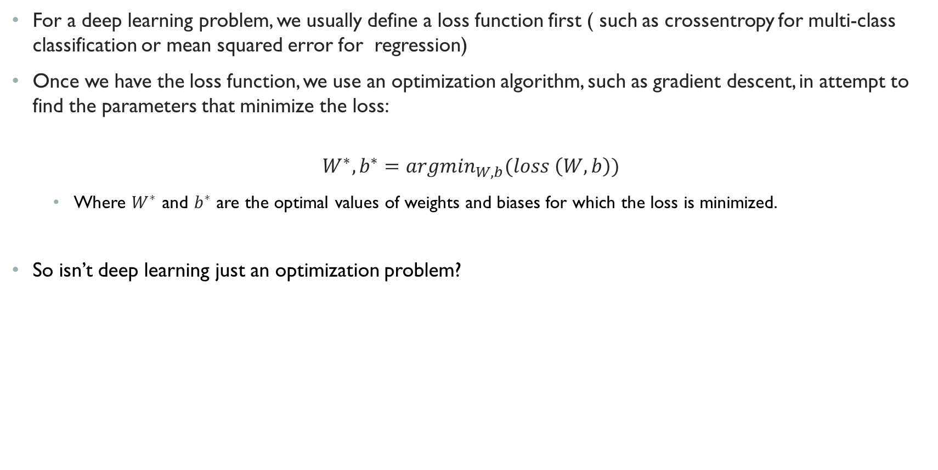
Optimization and Deep Learning
For a deep learning problem, we usually define a loss function first ( such as crossentropy for multi-class classification or mean squared error for regression)
Once we have the loss function, we use an optimization algorithm, such as gradient descent, in attempt to find the parameters that minimize the loss:
$$W^{∗},b^{∗}=argmin_{W,b}(loss \left(W,b\right))$$
Where $W^{∗}$ and $b^{∗}$ are the optimal values of weights and biases for which the loss is minimized.
So isn’t deep learning just an optimization problem?

Slide 4
How is Optimization Different Than deep learning
Although optimization provides a way to minimize the loss function for deep learning, in essence, the goals of optimization and deep learning are fundamentally different.
In optimization all we care about is finding the parameters that minimize or maximize a given function
In deep learning ( and machine learning in general), we are concerned about finding a suitable model, given a finite sample of data (i.e., training data).
What separates machine learning from optimization is that in machine learning we want the error on the test data to be as low as possible while optimizing the model’s parameters on the training data.
In other words, we are minimizing the training error but what we really want is to minimize the test error. If we were only concerned about minimizing the training error, then machine learning would have been just like an optimization problem.
This process is the source of overfitting because when we are minimizing the loss on the training data, we are always running into the danger of discovering some patterns that are specific to the training data which don’t hold up when we collect more data.
We have discussed overfitting and bias-variance trade-off in lecture 1. In the next lecture we will discuss techniques to battle overfitting in neural networks
In this lecture we discuss optimization challenges in deep learning and discuss algorithms which address those challenges.

Slide 5
Optimization Challenges
Ill-Conditioned Curvature
Local minimum and Saddle points
Numerical Instability, vanishing and exploding gradients

Slide 6
Optimization Challenges in deep Learning
In this lecture we are focusing specifically on the performance of the optimization algorithm in minimizing the training loss (rather than minimizing the generalization error). In the next lecture we discuss generalization error and techniques to battle overfitting.
As we will see later, using modern neural network libraries, such as Tensorflow, theano, torch, Keras, make it is very easy to stack some layers and train a deep neural network but it is not always easy to get it to work well.
So far, we talked about gradient descent as an optimization method to learn the parameters of a neural network
There are many challenges in gradient descent based optimization in neural network. Understanding these challenges helps us diagnose and debug our neural network model. Some of the most vexing challenges ones are
Ill conditioned curvature
Local Minima and saddle points
Instability ( Vanishing or exploding gradients or activations)
Notes:
Now we get to the most important part of this lecture: debugging gradient descent training. When you first learned to program, whenever something didn’t work, you might have looked through your code line by line to try and spot the mistake. This might have worked for 10-line programs, but it probably became unworkable for more complex programs. Line-by-line inspection doesn’t work very well in machine learning either — not just because the programs are complicated, but also because most of the problems we’re going to talk about can occur even for a correctly implemented training algorithm. E.g., if the problem is that you set the learning rate too small, you’re not going to be able to deduce this by looking at your code, since you don’t know ahead of time what the right learning rate is. Let’s make a list of various things that can go wrong, and how to diagnose and fix them

Slide 7
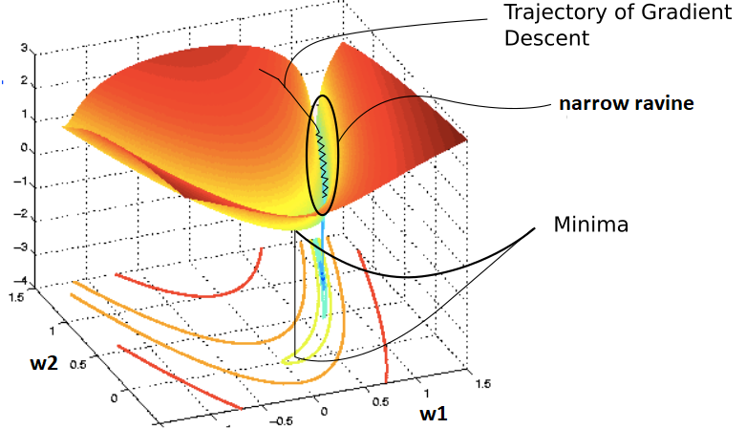
Ill Conditioned Curvature
In mathematics, condition number is a number representative of the change of an output proportionate to a change in the input of a function.
For example, if a small change in the input results in a small change in the output, the function produces a small condition number and is said to be well-conditioned.
Alternatively, if a small change in the input results in a large change in the output, the function produces a large condition number and is defined as ill-conditioned.
In the context of gradient based optimization, this means that the gradients with respect to some parameters may change direction much more rapidly compared to other parameters.
If we plot the loss function against the network parameters, this means that we see high curvatures in some directions and low curvatures in other directions ( for example, long narrow ravines)
Ill conditioned curvature is generally believed to be present in neural network
training and can cause gradient descent algorithm to get stuck in the sense
that even very small steps increase the loss function
Image source: https://blog.paperspace.com/intro-to-optimization-momentum-rmsprop-adam/

Slide 8
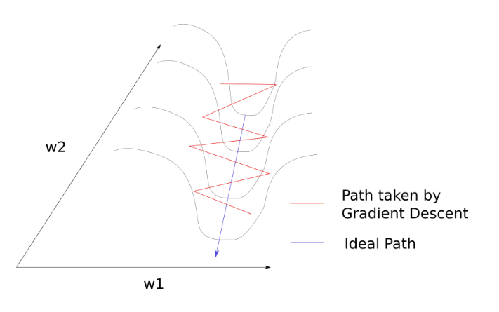
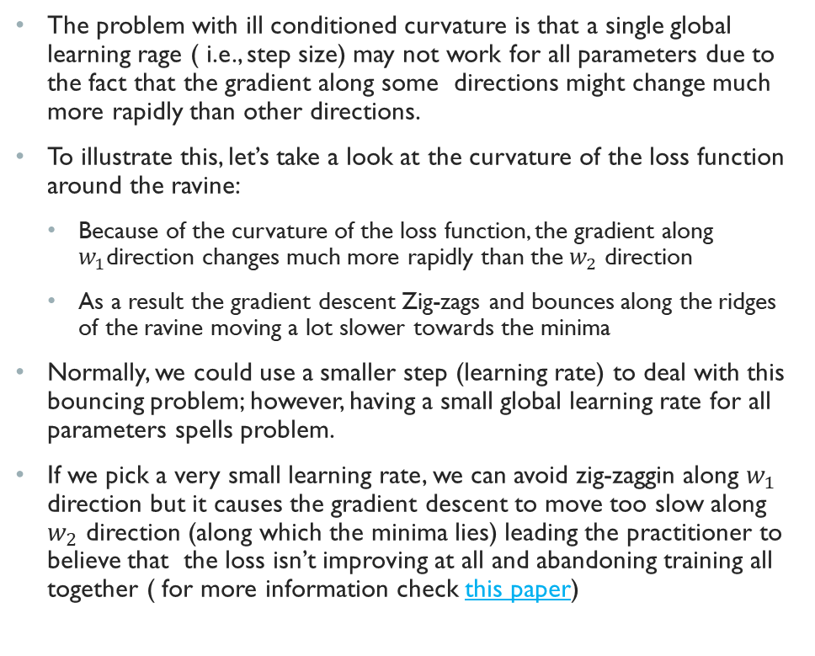
Problem with Ill Conditioned curvature
The problem with ill conditioned curvature is that a single global learning rage ( i.e., step size) may not work for all parameters due to the fact that the gradient along some directions might change much more rapidly than other directions.
To illustrate this, let’s take a look at the curvature of the loss function around the ravine:
Because of the curvature of the loss function, the gradient along $w_{1}$direction changes much more rapidly than the $w_{2}$ direction
As a result the gradient descent Zig-zags and bounces along the ridges of the ravine moving a lot slower towards the minima
Normally, we could use a smaller step (learning rate) to deal with this bouncing problem; however, having a small global learning rate for all parameters spells problem.
If we pick a very small learning rate, we can avoid zig-zaggin along $w_{1}$ direction but it causes the gradient descent to move too slow along $w_{2}$ direction (along which the minima lies) leading the practitioner to believe that the loss isn’t improving at all and abandoning training all together ( for more information check this paper)
Source:https://blog.paperspace.com/intro-to-optimization-momentum-rmsprop-adam/

Slide 9
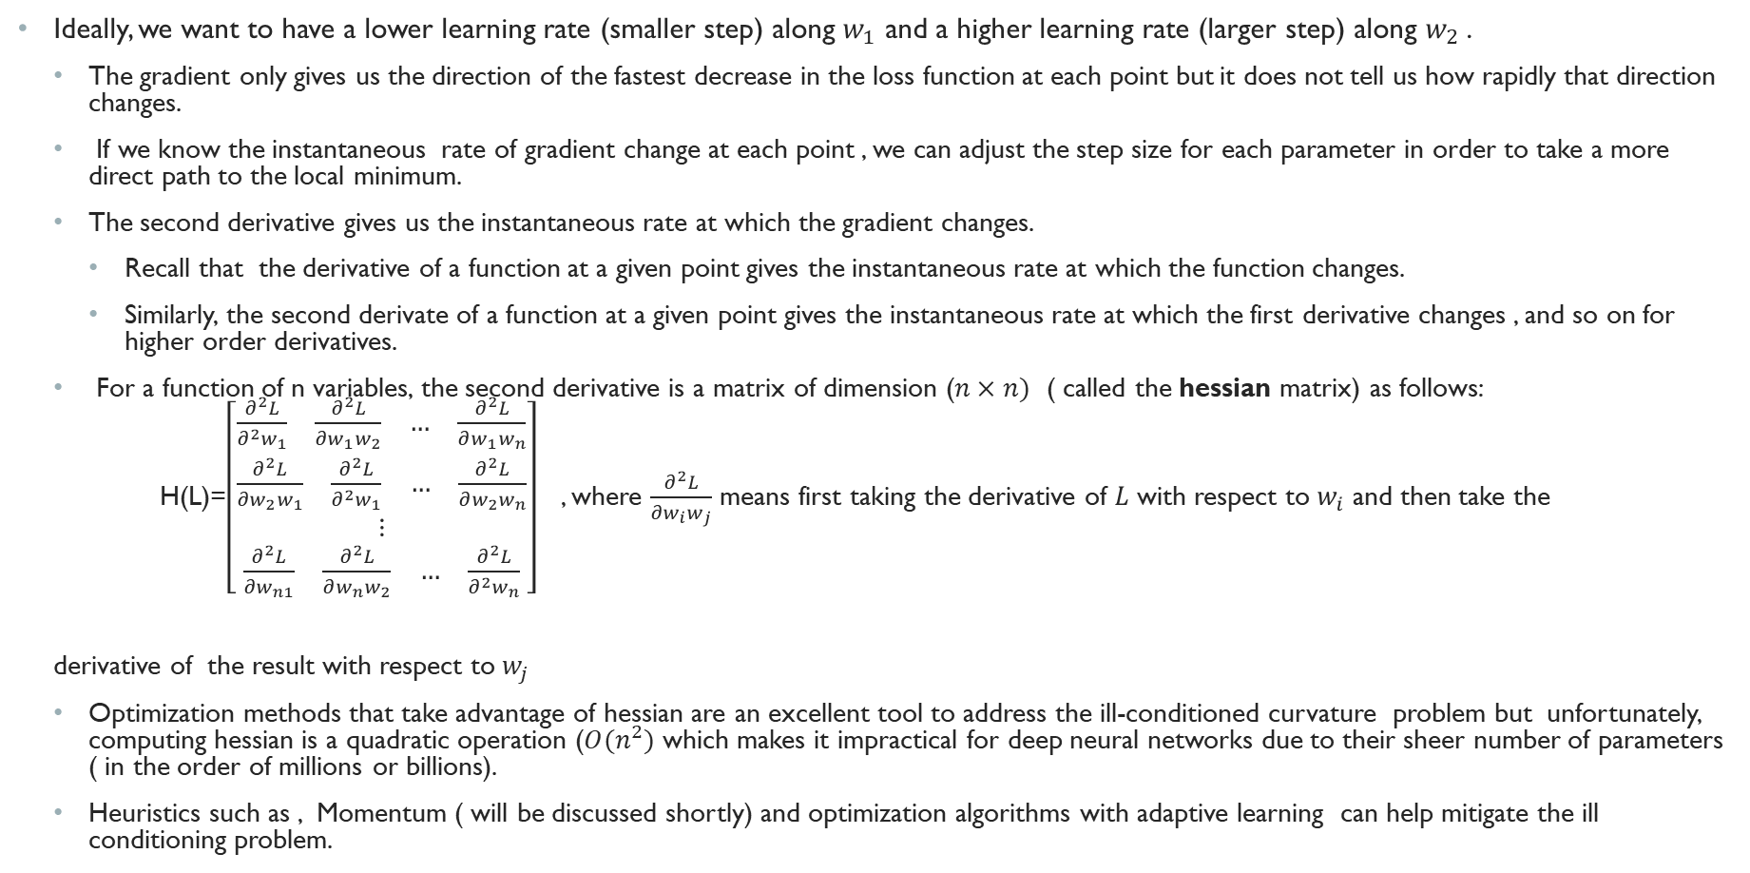
Problem with ill conditioned curvature (Cont.)
Ideally, we want to have a lower learning rate (smaller step) along $w_{1}$ and a higher learning rate (larger step) along $w_{2}$.
The gradient only gives us the direction of the fastest decrease in the loss function at each point but it does not tell us how rapidly that direction changes.
If we know the instantaneous rate of gradient change at each point , we can adjust the step size for each parameter in order to take a more direct path to the local minimum.
The second derivative gives us the instantaneous rate at which the gradient changes.
Recall that the derivative of a function at a given point gives the instantaneous rate at which the function changes.
Similarly, the second derivate of a function at a given point gives the instantaneous rate at which the first derivative changes , and so on for higher order derivatives.
For a function of n variables, the second derivative is a matrix of dimension ($n×n)$ ( called the hessian matrix) as follows:
H(L)=$\left[\begin{aligned}\begin{aligned}\begin{matrix}\frac{∂^{2}L}{∂^{2}w_{1}} & \begin{matrix}\begin{matrix}\frac{∂^{2}L}{{∂w}_{1}w_{2}} & …\end{matrix} & \frac{∂^{2}L}{∂w_{1}w_{n}}\end{matrix}\end{matrix} \\ \begin{matrix}\frac{∂^{2}L}{∂w_{2}w_{1}} & \begin{matrix}\begin{matrix}\frac{∂^{2}L}{∂^{2}w_{1}} & …\end{matrix} & \frac{∂^{2}L}{∂w_{2}w_{n}}\end{matrix}\end{matrix} \\ ⋮\end{aligned} \\ \begin{matrix}\frac{∂^{2}L}{∂w_{n1}} & \begin{matrix}\begin{matrix}\frac{∂^{2}L}{∂w_{n}w_{2}} & …\end{matrix} & \frac{∂^{2}L}{∂^{2}w_{n}}\end{matrix}\end{matrix}\end{aligned}\right]$ , where $\frac{∂^{2}L}{{∂w}_{i}w_{j}}$ means first taking the derivative of $L$ with respect to $w_{i}$ and then take the
derivative of the result with respect to $w_{j}$
Optimization methods that take advantage of hessian are an excellent tool to address the ill-conditioned curvature problem but unfortunately, computing hessian is a quadratic operation ($O(n^{2})$ which makes it impractical for deep neural networks due to their sheer number of parameters ( in the order of millions or billions).
Heuristics such as , Momentum ( will be discussed shortly) and optimization algorithms with adaptive learning can help mitigate the ill conditioning problem.

Slide 10
Optimization Challenges
Ill-Conditioned Curvature
Local minimum and Saddle points
Numerical Instability, vanishing and exploding gradients

Slide 11
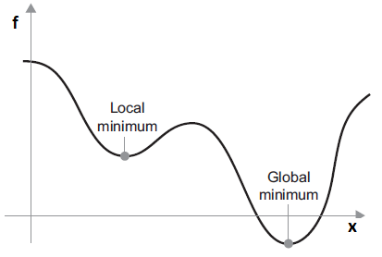
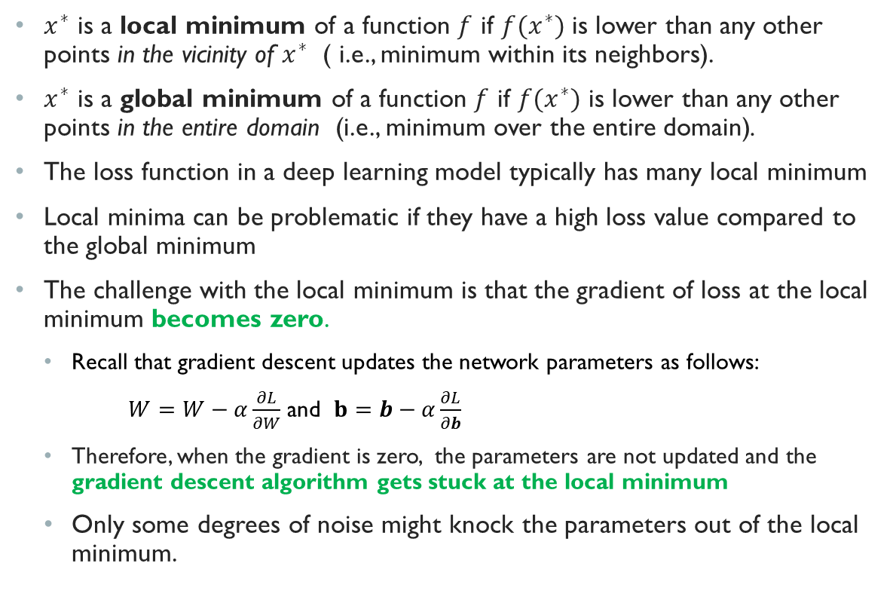
Local Minima
$x^{∗}$ is a local minimum of a function $f$ if $f(x^{∗})$ is lower than any other points in the vicinity of $x^{∗}$ ( i.e., minimum within its neighbors).
$x^{∗}$ is a global minimum of a function $f$ if $f(x^{∗})$ is lower than any other points in the entire domain (i.e., minimum over the entire domain).
The loss function in a deep learning model typically has many local minimum
Local minima can be problematic if they have a high loss value compared to the global minimum
The challenge with the local minimum is that the gradient of loss at the local minimum becomes zero.
Recall that gradient descent updates the network parameters as follows:
$W=W−α\frac{∂L}{∂W}$ and $b=b−α\frac{∂L}{∂b}$
Therefore, when the gradient is zero, the parameters are not updated and the gradient descent algorithm gets stuck at the local minimum
Only some degrees of noise might knock the parameters out of the local minimum.

Slide 12
Local Minima in practice
For many years, most practitioners believed that local minima were a common problem plaguing neural network optimization.
Today, that does not appear to be the case. Most experts suspect that, for suﬃciently large neural networks, most local minima have a loss function value and generalization characteristics that are very similar compared to global minimum.
For more detained information, you can read this paper . In this paper, Goodfellow et. al. showed that for the variety of the state of the art neural networks that were proved to achieve a good solution if you draw a straight line from the initial random parameters to the final solution and change the parameters along that line, the learning algorithm does not appear to encounter problem regarding the local minima.
This means that if we know exactly which direction to move to in, then the gradient based optimization for most practical neural network is not hindered by the problem of local minima.

Slide 13
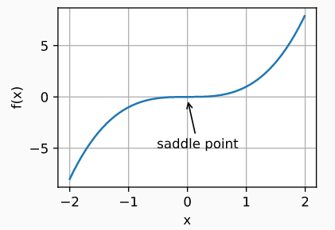
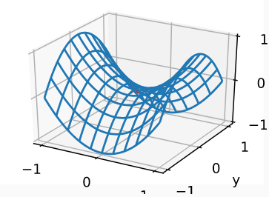
Saddle point
A saddle point is a point in which the gradient is zero but the point is neither local nor global minimum or maximum.
Some points around the saddle point have smaller loss than the saddle point while others have greater loss.
The gradient can often become very small near the saddle point and the learning slows down considerably
Example of a saddle point for a single variable function
Example of a saddle point for a two variable function

Slide 14
Saddle points in practice
In general in a high dimensional space, such as most practical deep neural networks, local minima are rare and saddle points are much more common
Fortunately, the minibatch gradient descent algorithm ( will be discussed later) empirically seems to slow down but ultimately be able to escape saddle points
Optimization methods with adaptive learning rate such as AdaGrad, RMSProp and Adam ( will be discussed later) can speed up training and escape saddle points faster.

Slide 15
Optimization Challenges
Ill-Conditioned Curvature
Local minimum and Saddle points
Numerical Instability, vanishing and exploding gradients

Slide 16
Numerical instability During backprop
As we have seen previously, the backprop algorithm performs a chain of matrix multiplications to compute the gradients.
When we have a deep neural network consisting of tens or hundreds of layers, the gradients in early layers are the product of gradients from all the other subsequent layers. In this situation, it is possible for the gradients to become unstable after propagated through some layers. There are two sources of instability:
Vanishing gradients: If gradients are small ( less than one) and we multiply many of these small numbers together we run into the risk of having numerical underflow. That is, the product of many small numbers may result in a number which has a smaller magnitude than a computer can represent.
Exploding gradient: if gradients are large (greater than one) and we multiply many of these large gradients together we run in to the risk of having numerical overflow which means we end up with a number that is too large to be represented by a computer.
Vanishing or exploding gradients can result in NAN (Not a Number) error during training of neural networks.
Even if vanishing or exploding gradients do not cause numerical under or overflow, they are still a big problem because:
Vanishing gradients can stall the gradient descent algorithm or cause it to converge (reach a solution) very slowly
Exploding gradients can make the gradient descent algorithm very unstable and unable to converge to a solution or learn from the training data.

Slide 17
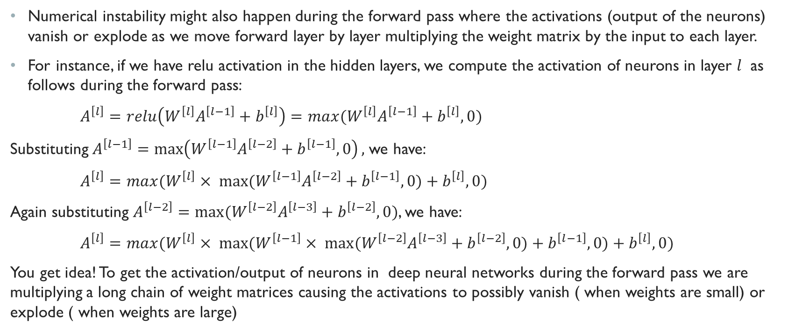
Numerical instability during the forward pass
Numerical instability might also happen during the forward pass where the activations (output of the neurons) vanish or explode as we move forward layer by layer multiplying the weight matrix by the input to each layer.
For instance, if we have relu activation in the hidden layers, we compute the activation of neurons in layer $l$ as follows during the forward pass:
$A^{\left[l\right]}={relu\left(W^{\left[l\right]}A^{\left[l−1\right]}+b^{\left[l\right]}\right)=max(W}^{\left[l\right]}A^{\left[l−1\right]}+b^{\left[l\right]},0)$
Substituting $A^{\left[l−1\right]}=$ $\max\left({W^{\left[l−1\right]}A}^{\left[l−2\right]}+b^{\left[l−1\right]},0\right),$we have:
$A^{\left[l\right]}={max(W}^{\left[l\right]}× max⁡({W^{\left[l−1\right]}A}^{\left[l−2\right]}+b^{\left[l−1\right]},0)+b^{\left[l\right]},0)$
Again substituting $A^{\left[l−2\right]}={max⁡(W^{\left[l−2\right]}A}^{\left[l−3\right]}+b^{\left[l−2\right]},0)$, we have:
$A^{\left[l\right]}={max(W}^{\left[l\right]}× max⁡({W^{\left[l−1\right]}× max⁡(W^{\left[l−2\right]}A}^{\left[l−3\right]}+b^{\left[l−2\right]},0)+b^{\left[l−1\right]},0)+b^{\left[l\right]},0)$
You get idea! To get the activation/output of neurons in deep neural networks during the forward pass we are multiplying a long chain of weight matrices causing the activations to possibly vanish ( when weights are small) or explode ( when weights are large)

Slide 18
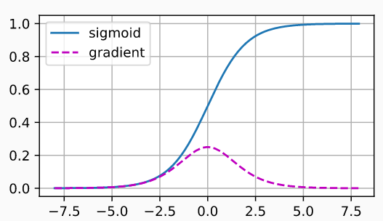
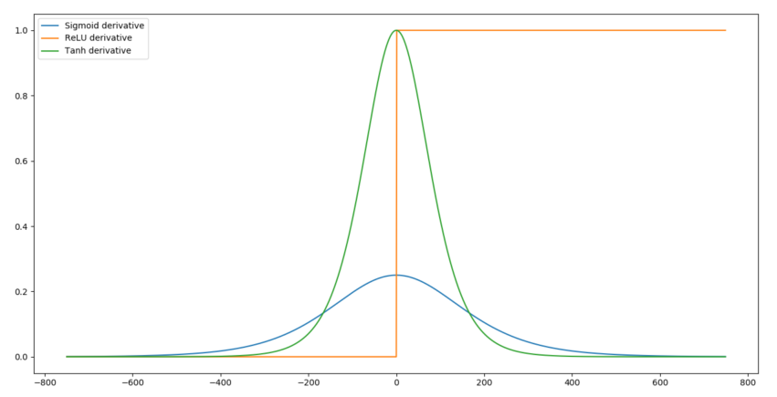
Numerical instability and The choice of Activation function
One frequent culprit for vanishing gradient problem is the choice of activation function for the hidden layers.
Consider the sigmoid activation. As you can see in the figure, the gradient of sigmoid is close to zero when its input is large or small.
When backpropagating through many layers with sigmoid activation, it is very likely that the overall product after some layers will become close to zero and the gradients start to vanish.
Consequently, the gradient descent algorithm stalls and the parameters of those layers will hardly get updated in each iteration.
Other activations functions with squashing effect, such as tanh, also suffer from similar problem.
Relu activation on the other hand does not have the squashing effect and its gradient is equal to one over half of its input space.
This is one of the reasons that Relu has emerged as the default choice for the activation of the hidden layers in a deep neural network and works very well in practice.

Slide 19
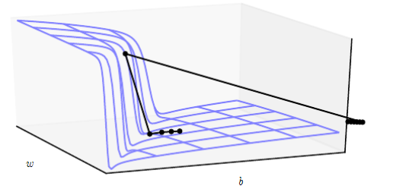

The problem with Exploding Gradients
The gradient descent algorithm typically works best when the updates to the network parameters in each iteration is small and controlled.
When the gradients are too large, the learning becomes unstable.
This is because, the gradient descent algorithm might make too large of an update to a parameter, essentially catapulting the parameter very far and possibly losing most of the optimization work that has been done.
The loss function in neural networks with many layers often have extremely steep regions resembling cliffs. This results from multiplication of several large gradients together.
When the gradients are too large, the gradient update step can move the parameters extremely far. In this figure, we are approaching the cliff from below. At the bottom of this small ravine, the gradient is large and so the gradient descent makes a large update and overshoots the parameter up the cliff. Then at the top, it receives a very large gradient and catapult the parameter outside of the axes of the plot undoing all the optimization work
$$loss(w,b)$$

Slide 20
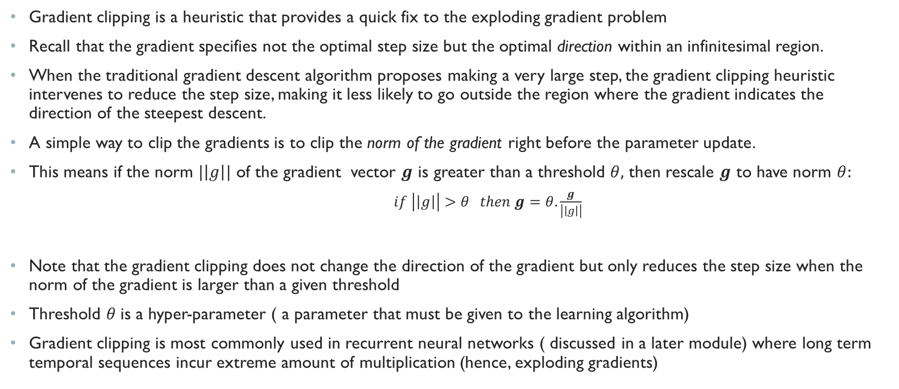
Gradient clipping
Gradient clipping is a heuristic that provides a quick fix to the exploding gradient problem
Recall that the gradient specifies not the optimal step size but the optimal direction within an infinitesimal region.
When the traditional gradient descent algorithm proposes making a very large step, the gradient clipping heuristic intervenes to reduce the step size, making it less likely to go outside the region where the gradient indicates the direction of the steepest descent.
A simple way to clip the gradients is to clip the norm of the gradient right before the parameter update.
This means if the norm $|\left|g\right||$ of the gradient vector $g$ is greater than a threshold $θ,$ then rescale $g$ to have norm $θ:$
$if \left|\left|g\right|\right|>θ then g=θ.\frac{g}{\left|\left|g\right|\right|}$
Note that the gradient clipping does not change the direction of the gradient but only reduces the step size when the norm of the gradient is larger than a given threshold
Threshold $θ$is a hyper-parameter ( a parameter that must be given to the learning algorithm)
Gradient clipping is most commonly used in recurrent neural networks ( discussed in a later module) where long term temporal sequences incur extreme amount of multiplication (hence, exploding gradients)

Slide 21
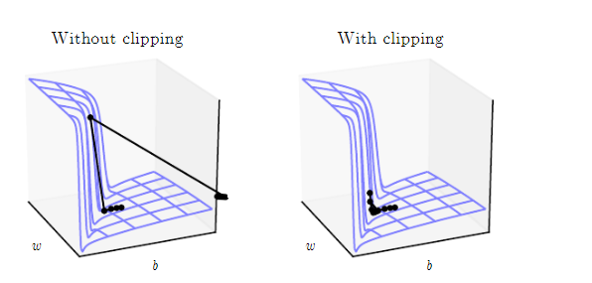


Example effect of Gradient clipping
Gradient descent with gradient clipping has a more moderate reaction to the cliff. While it does ascend the cliﬀ face, the step size is restricted so that it cannot be propelled away from the steep region near the solution
$$loss(w,b)$$
$$loss(w,b)$$

Slide 22
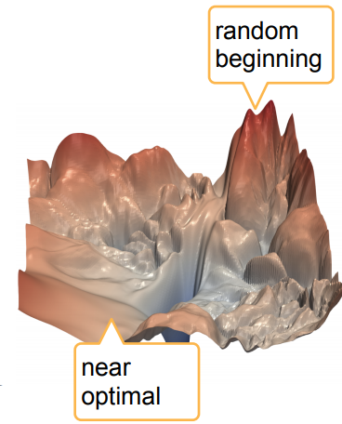
Numerical instability and parameter initialization
As mentioned in previous modules, the gradient descent algorithm is iterative and thus requires the user to specify some initial points ( i.e., initial parameter values) to begin the iterations.
The performance of gradient descent in a deep neural network is strongly affected by the choice of initial parameter values
Some initial points may be so unstable that the algorithm encounters numerical instability and fails altogether ( e.g., returns NAN for loss)
The choice of initial points can also determine how quickly the learning converges and whether it converges to a point with high or low cost.
Typically we initialize the biases of all neurons to a constant ( for instance zero) and only initialize the weights randomly.

Slide 23
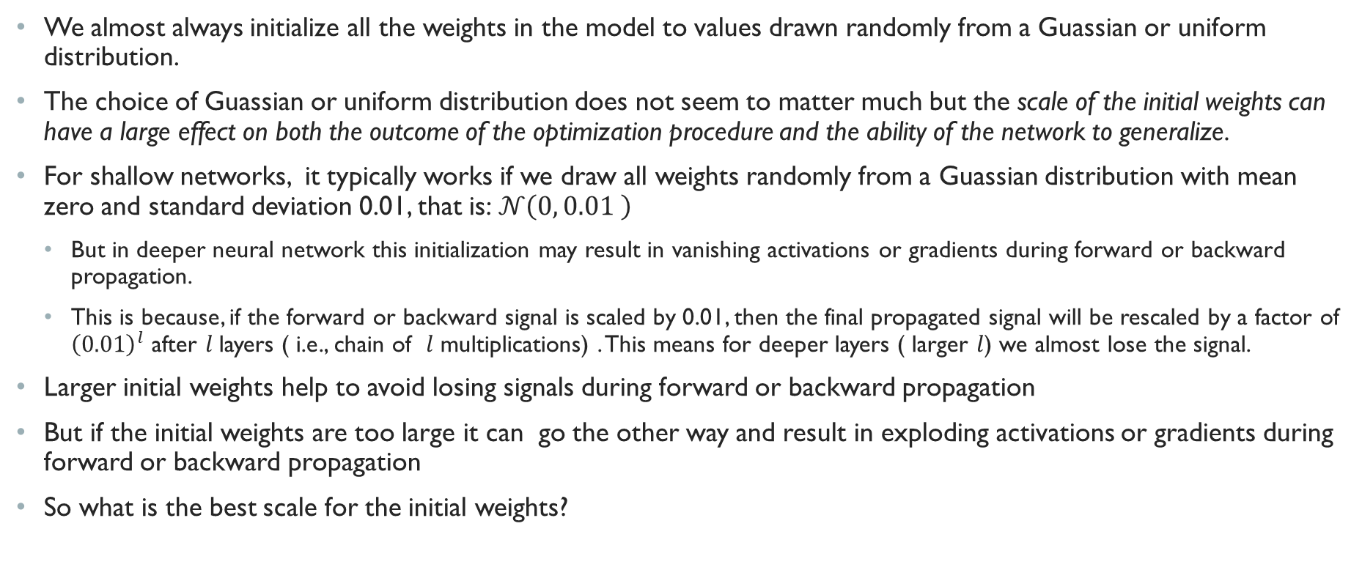
weight initialization
We almost always initialize all the weights in the model to values drawn randomly from a Guassian or uniform distribution.
The choice of Guassian or uniform distribution does not seem to matter much but the scale of the initial weights can have a large effect on both the outcome of the optimization procedure and the ability of the network to generalize.
For shallow networks, it typically works if we draw all weights randomly from a Guassian distribution with mean zero and standard deviation 0.01, that is:$𝒩\left(0, 0.01 \right)$
But in deeper neural network this initialization may result in vanishing activations or gradients during forward or backward propagation.
This is because, if the forward or backward signal is scaled by 0.01, then the final propagated signal will be rescaled by a factor of ${\left(0.01\right)}^{l}$ after $l$layers ( i.e., chain of $l$ multiplications) . This means for deeper layers ( larger $l$) we almost lose the signal.
Larger initial weights help to avoid losing signals during forward or backward propagation
But if the initial weights are too large it can go the other way and result in exploding activations or gradients during forward or backward propagation
So what is the best scale for the initial weights?

Slide 24

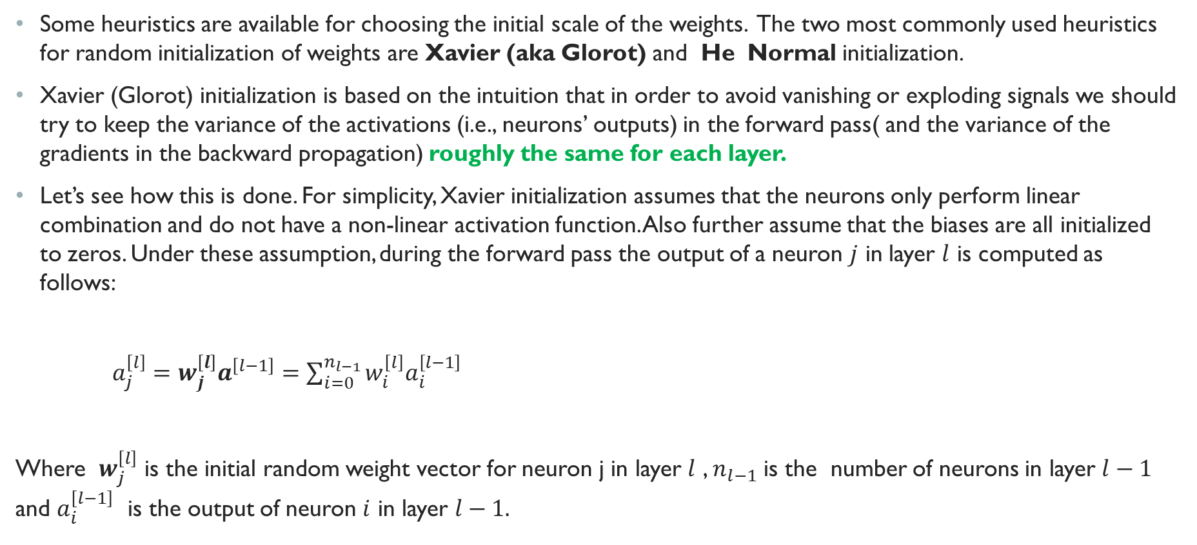


Xavier (Glorot) Initialization
Some heuristics are available for choosing the initial scale of the weights. The two most commonly used heuristics for random initialization of weights are Xavier (aka Glorot) and He Normal initialization.
Xavier (Glorot) initialization is based on the intuition that in order to avoid vanishing or exploding signals we should try to keep the variance of the activations (i.e., neurons’ outputs) in the forward pass( and the variance of the gradients in the backward propagation) roughly the same for each layer.
Let’s see how this is done. For simplicity, Xavier initialization assumes that the neurons only perform linear combination and do not have a non-linear activation function. Also further assume that the biases are all initialized to zeros. Under these assumption, during the forward pass the output of a neuron $j$ in layer $l$ is computed as follows:
$a_{j}^{\left[l\right]}=w_{j}^{\left[l\right]}a^{\left[l−1\right]}=\sum_{i=0}^{n_{l−1}}{{w_{i}^{\left[l\right]}a}_{i}^{\left[l−1\right]}}$
Where $w_{j}^{\left[l\right]}$ is the initial random weight vector for neuron j in layer $l$ , $n_{l−1}$ is the number of neurons in layer $l−1$ and $a_{i}^{\left[l−1\right]}$ is the output of neuron $i$ in layer $l−1.$
$$a^{\left[l−1\right]}$$
$$a^{\left[l\right]}=w_{j}^{\left[l\right]}a^{\left[l\right]}$$
$$<w_{j}^{[l]}>$$

Slide 25
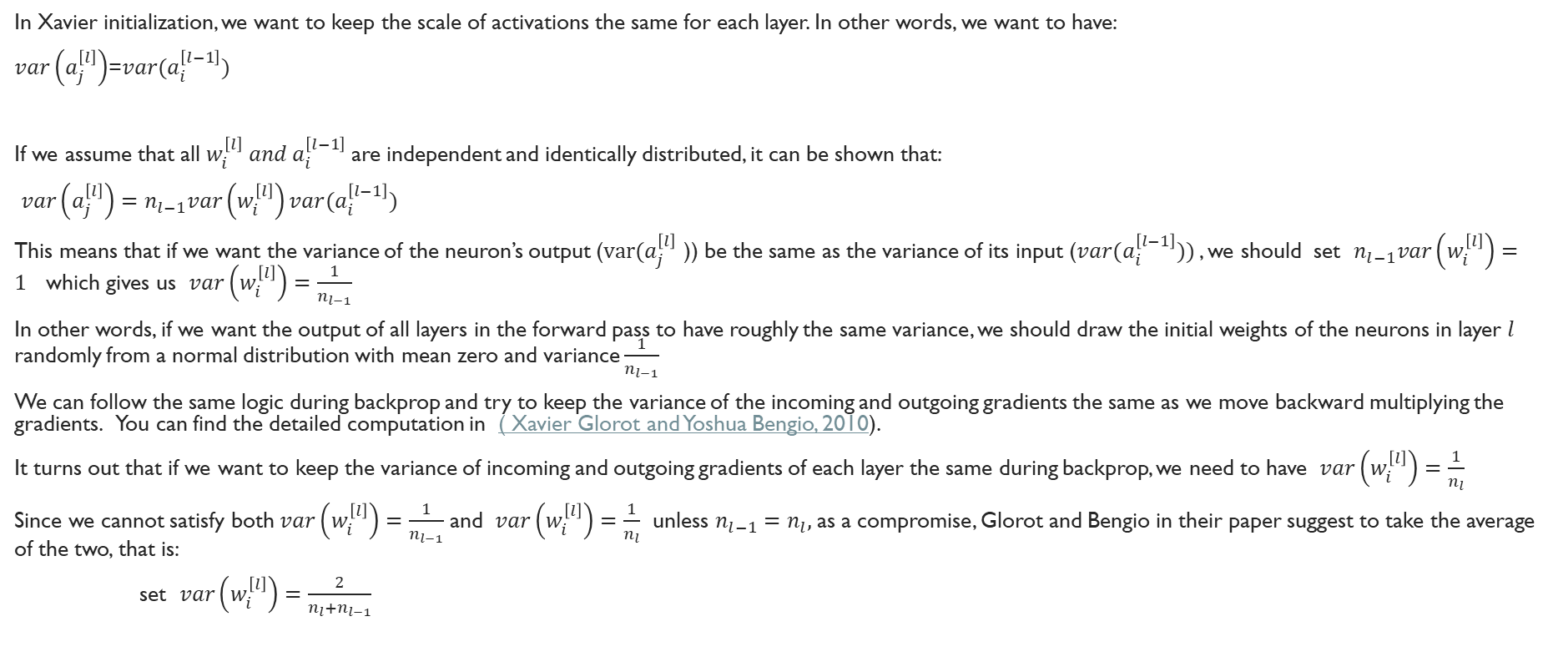
Xavier Initialization (Cont.)
In Xavier initialization, we want to keep the scale of activations the same for each layer. In other words, we want to have:
$var\left(a_{j}^{\left[l\right]}\right)$=$var(a_{i}^{\left[l−1\right]})$
If we assume that all $w_{i}^{\left[l\right]} and a_{i}^{\left[l−1\right]}$are independent and identically distributed, it can be shown that:
$var\left(a_{j}^{\left[l\right]}\right)=n_{l−1}var\left(w_{i}^{\left[l\right]}\right)var(a_{i}^{\left[l−1\right]})$
This means that if we want the variance of the neuron’s output ($var(a_{j}^{\left[l\right]}$ )) be the same as the variance of its input ($var(a_{i}^{\left[l−1\right]}))$, we should set $n_{l−1}var\left(w_{i}^{\left[l\right]}\right)=1$ which gives us $var\left(w_{i}^{\left[l\right]}\right)=\frac{1}{n_{l−1}}$
In other words, if we want the output of all layers in the forward pass to have roughly the same variance, we should draw the initial weights of the neurons in layer $l$ randomly from a normal distribution with mean zero and variance $\frac{1}{n_{l−1}}$
We can follow the same logic during backprop and try to keep the variance of the incoming and outgoing gradients the same as we move backward multiplying the gradients. You can find the detailed computation in ( Xavier Glorot and Yoshua Bengio, 2010).
It turns out that if we want to keep the variance of incoming and outgoing gradients of each layer the same during backprop, we need to have $var\left(w_{i}^{\left[l\right]}\right)=\frac{1}{n_{l}}$
Since we cannot satisfy both $var\left(w_{i}^{\left[l\right]}\right)=\frac{1}{n_{l−1}}$ and $var\left(w_{i}^{\left[l\right]}\right)=\frac{1}{n_{l}}$ unless $n_{l−1}=n_{l},$as a compromise, Glorot and Bengio in their paper suggest to take the average of the two, that is:
set $var\left(w_{i}^{\left[l\right]}\right)=\frac{2}{n_{l}+n_{l−1}}$

Slide 26
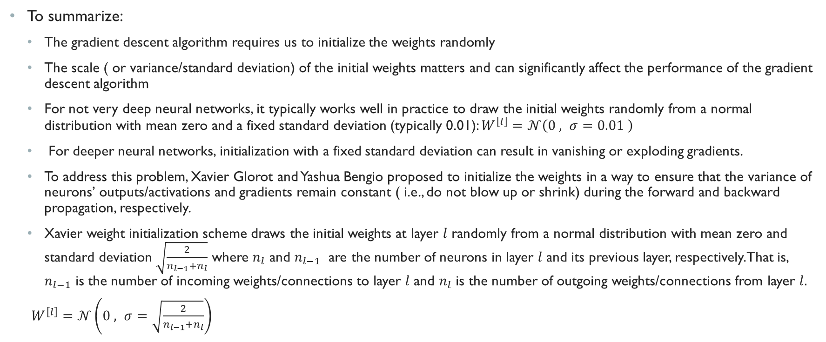
Xavier Initialization (Cont.)
To summarize:
The gradient descent algorithm requires us to initialize the weights randomly
The scale ( or variance/standard deviation) of the initial weights matters and can significantly affect the performance of the gradient descent algorithm
For not very deep neural networks, it typically works well in practice to draw the initial weights randomly from a normal distribution with mean zero and a fixed standard deviation (typically 0.01): $W^{\left[l\right]}=𝒩\left(0 , σ=0.01 \right)$
For deeper neural networks, initialization with a fixed standard deviation can result in vanishing or exploding gradients.
To address this problem, Xavier Glorot and Yashua Bengio proposed to initialize the weights in a way to ensure that the variance of neurons’ outputs/activations and gradients remain constant ( i.e., do not blow up or shrink) during the forward and backward propagation, respectively.
Xavier weight initialization scheme draws the initial weights at layer $l$ randomly from a normal distribution with mean zero and standard deviation $\sqrt{\frac{2}{n_{l−1}+n_{l}}}$ where $n_{l}$ and $n_{l−1}$ are the number of neurons in layer $l$ and its previous layer, respectively. That is, $n_{l−1}$ is the number of incoming weights/connections to layer $l$ and $n_{l}$ is the number of outgoing weights/connections from layer $l.$
$W^{\left[l\right]}=𝒩\left(0 , σ=\sqrt{\frac{2}{n_{l−1}+n_{l}}}\right)$

Slide 27
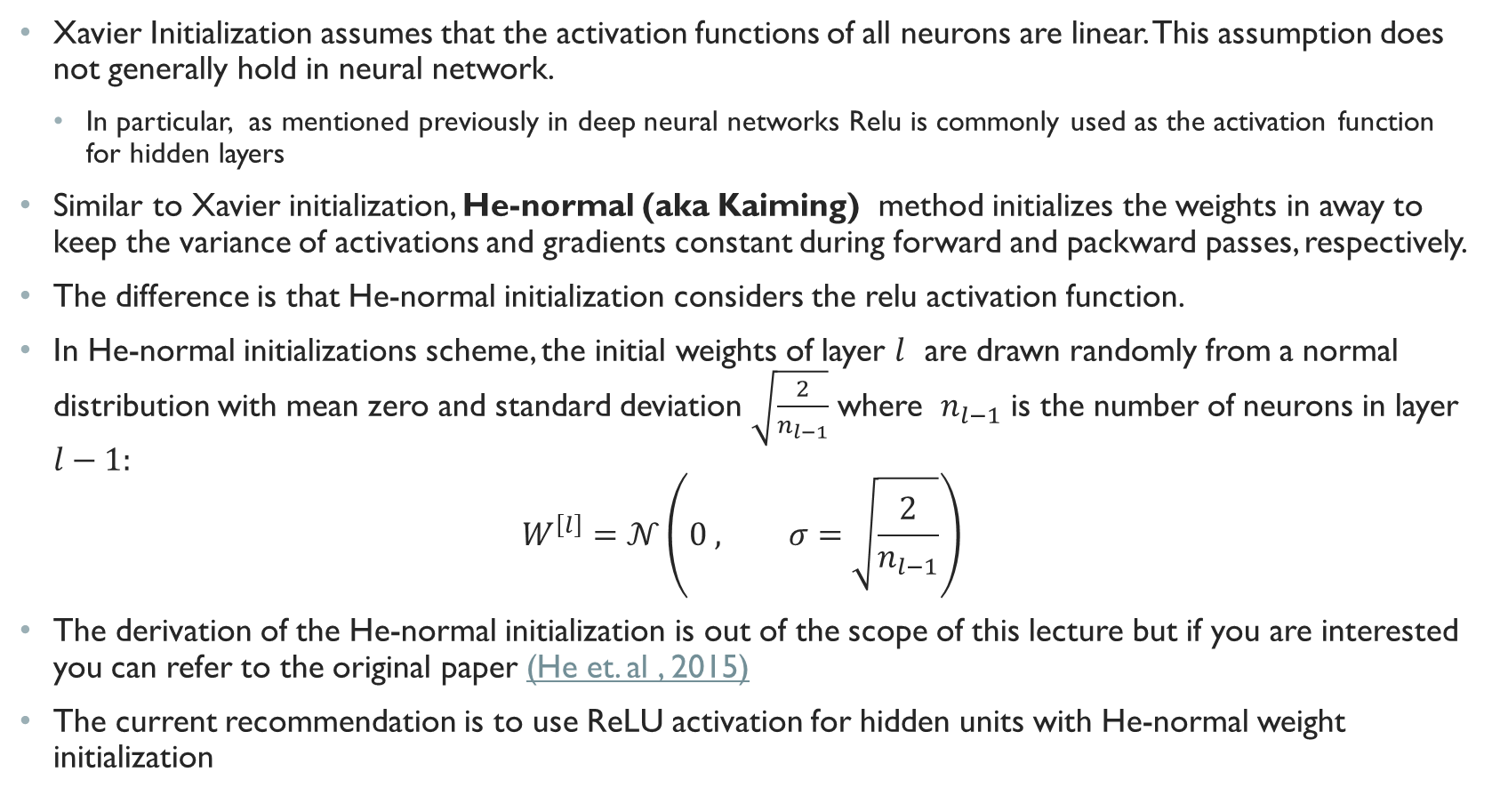
He-Normal Initialization
Xavier Initialization assumes that the activation functions of all neurons are linear. This assumption does not generally hold in neural network.
In particular, as mentioned previously in deep neural networks Relu is commonly used as the activation function for hidden layers
Similar to Xavier initialization, He-normal (aka Kaiming) method initializes the weights in away to keep the variance of activations and gradients constant during forward and packward passes, respectively.
The difference is that He-normal initialization considers the relu activation function.
In He-normal initializations scheme, the initial weights of layer $l$ are drawn randomly from a normal distribution with mean zero and standard deviation $\sqrt{\frac{2}{n_{l−1}}}$ where $n_{l−1}$ is the number of neurons in layer $l−1:$
$$W^{\left[l\right]}=𝒩\left(0 , σ=\sqrt{\frac{2}{n_{l−1}}}\right)$$
The derivation of the He-normal initialization is out of the scope of this lecture but if you are interested you can refer to the original paper (He et. al , 2015)
The current recommendation is to use ReLU activation for hidden units with He-normal weight initialization

Slide 28
Weight initialization example
Please follow this link to open and run a python notebook which illustrates the initialization schemes we discussed in this lecture and how they address the vanishing/exploding activations during the forward pass.

Slide 29
Optimization Algorithms
Stochastic Gradient Descent
Minibatch Gradient Descent
SGD with Momentum
Algorithms with Adaptive Learning Rate
Adagrad
RMSprop
Adam

Slide 30
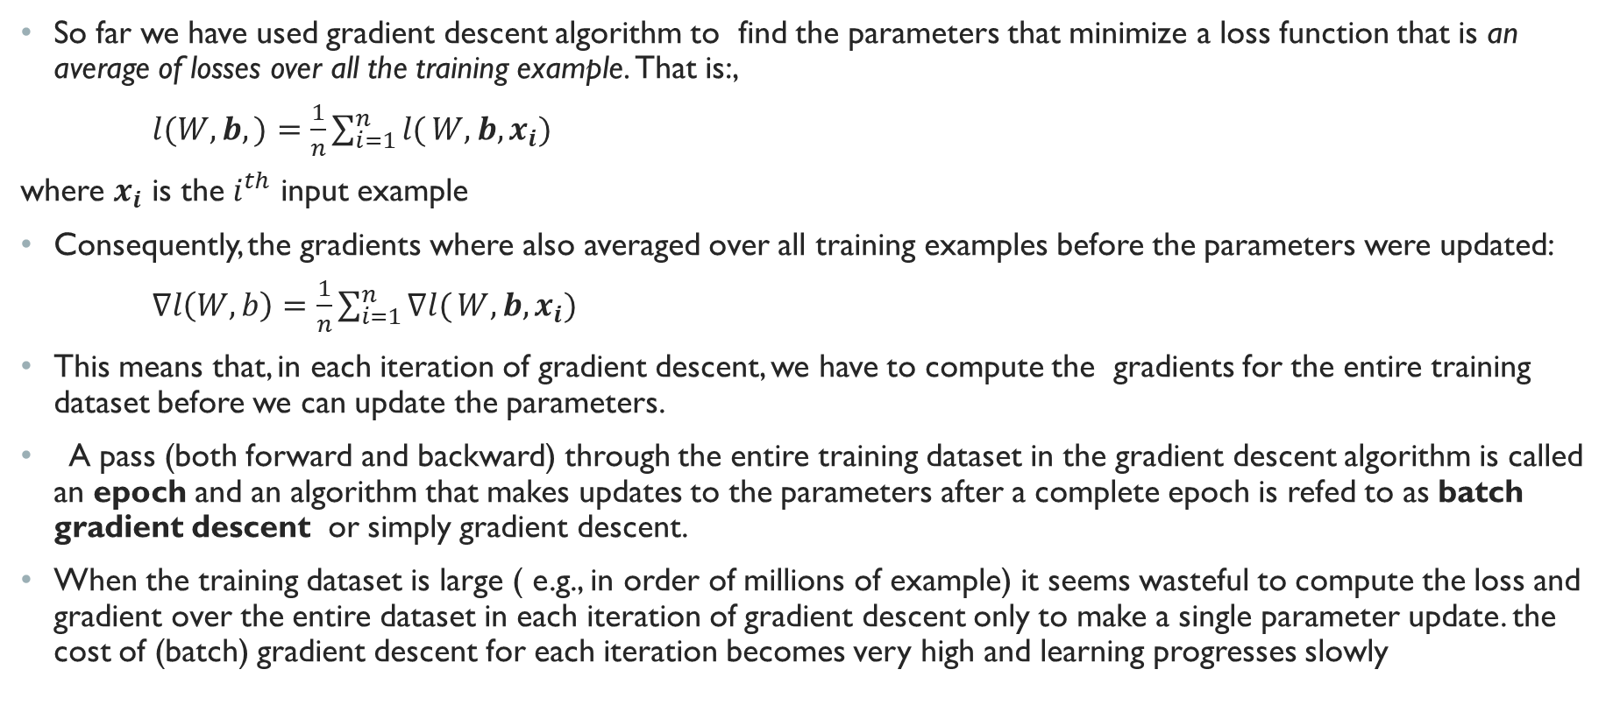
( Batch) Gradient Descent
So far we have used gradient descent algorithm to find the parameters that minimize a loss function that is an average of losses over all the training example. That is:,
$l(W,b,)=\frac{1}{n}\sum_{i=1}^{n}{l(}W,b, x_{i})$
where $x_{i}$ is the $i^{th}$ input example
Consequently, the gradients where also averaged over all training examples before the parameters were updated:
$∇l\left(W,b\right)=\frac{1}{n}\sum_{i=1}^{n}{∇l(}W,b, x_{i})$
This means that, in each iteration of gradient descent, we have to compute the gradients for the entire training dataset before we can update the parameters.
A pass (both forward and backward) through the entire training dataset in the gradient descent algorithm is called an epoch and an algorithm that makes updates to the parameters after a complete epoch is refed to as batch gradient descent or simply gradient descent.
When the training dataset is large ( e.g., in order of millions of example) it seems wasteful to compute the loss and gradient over the entire dataset in each iteration of gradient descent only to make a single parameter update. the cost of (batch) gradient descent for each iteration becomes very high and learning progresses slowly

Slide 31
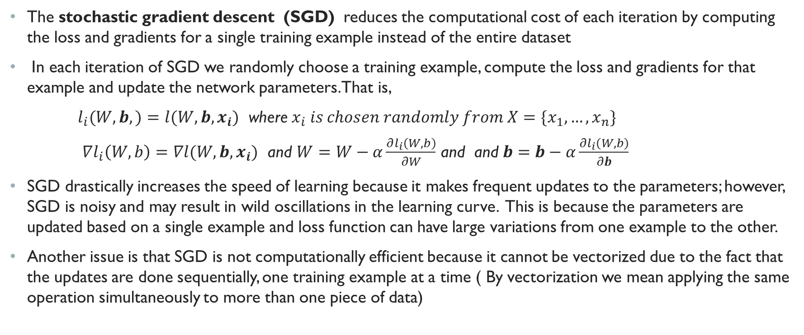
Stochastic Gradient Descent
The stochastic gradient descent (SGD) reduces the computational cost of each iteration by computing the loss and gradients for a single training example instead of the entire dataset
In each iteration of SGD we randomly choose a training example, compute the loss and gradients for that example and update the network parameters. That is,
$l_{i}(W,b,)=l(W,b, x_{i})$ where $x_{i} is chosen randomly from X=\{x_{1},…,x_{n}\}$
$∇l_{i}\left(W,b\right)=∇l(W,b, x_{i})$ and $W=W−α\frac{∂l_{i}\left(W,b\right)}{∂W}$ and and $b=b−α\frac{∂l_{i}\left(W,b\right)}{∂b}$
SGD drastically increases the speed of learning because it makes frequent updates to the parameters; however, SGD is noisy and may result in wild oscillations in the learning curve. This is because the parameters are updated based on a single example and loss function can have large variations from one example to the other.
Another issue is that SGD is not computationally efficient because it cannot be vectorized due to the fact that the updates are done sequentially, one training example at a time ( By vectorization we mean applying the same operation simultaneously to more than one piece of data)

Slide 32
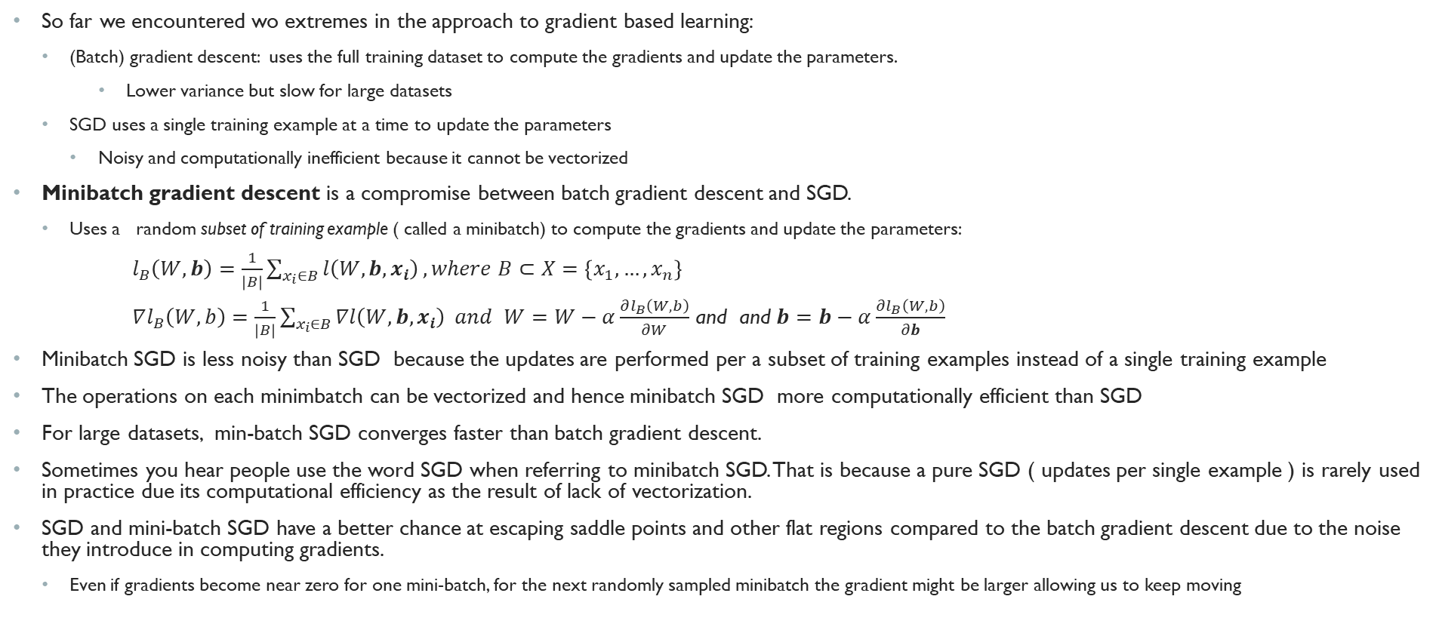
MiniBatch Gradient Descent
So far we encountered wo extremes in the approach to gradient based learning:
(Batch) gradient descent: uses the full training dataset to compute the gradients and update the parameters.
Lower variance but slow for large datasets
SGD uses a single training example at a time to update the parameters
Noisy and computationally inefficient because it cannot be vectorized
Minibatch gradient descent is a compromise between batch gradient descent and SGD.
Uses a random subset of training example ( called a minibatch) to compute the gradients and update the parameters:
$l_{B}\left(W,b\right)=\frac{1}{\left|B\right|}\sum_{x_{i}∈B}{l\left(W,b, x_{i}\right)}, where B⊂X=\left\{x_{1},…,x_{n}\right\}$
$∇l_{B}\left(W,b\right)=\frac{1}{\left|B\right|}\sum_{x_{i}∈B}{∇l\left(W,b, x_{i}\right)} and$ $W=W−α\frac{∂l_{B}\left(W,b\right)}{∂W}$ and and $b=b−α\frac{∂l_{B}\left(W,b\right)}{∂b}$
Minibatch SGD is less noisy than SGD because the updates are performed per a subset of training examples instead of a single training example
The operations on each minimbatch can be vectorized and hence minibatch SGD more computationally efficient than SGD
For large datasets, min-batch SGD converges faster than batch gradient descent.
Sometimes you hear people use the word SGD when referring to minibatch SGD. That is because a pure SGD ( updates per single example ) is rarely used in practice due its computational efficiency as the result of lack of vectorization.
SGD and mini-batch SGD have a better chance at escaping saddle points and other flat regions compared to the batch gradient descent due to the noise they introduce in computing gradients.
Even if gradients become near zero for one mini-batch, for the next randomly sampled minibatch the gradient might be larger allowing us to keep moving

Slide 33
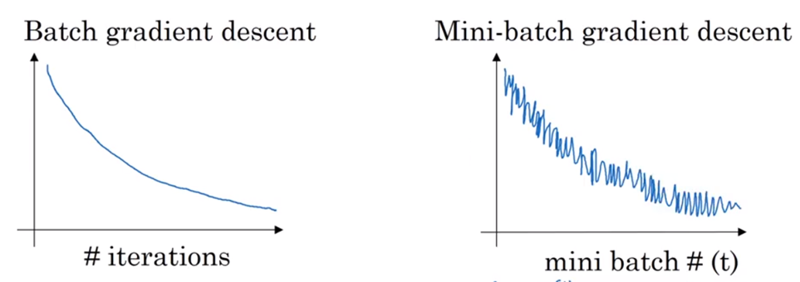


Learning curve in Gradient Descent vs Minibatch SGD
$$loss$$
$$loss$$
Image source:https://www.coursera.org/learn/deep-neural-network/lecture/lBXu8/understanding-mini-batch-gradient-descent
If learning rate is not too large, we expect that the loss function decrease with each iteration of batch gradient descent because updates are done per the entire training data. With minibatch gradient descent the curve may be noisy ( due to the variations of training examples and consequently, the variation of gradients between mini batches) but should generally have a downward trend

Slide 34
Choosing the size of the minibatch
The size of the mini-batch (also referred to as batch size) is a hyperparameter that needs tuning
If batch-size is too small (close to one) , then minibatch SGD will resemble the stochastic SGD
Too noisy, computationally inefficient
If batch-size is too large ( close to the size of the entire training data) , then minibatch SGD will resemble the batch gradient descent
Each iteration is too slow
Rule of thump:
If your dataset is small ( in particular, if it fits in your GPU or CPU memory, then use batch gradient descent)
Otherwise, choose a batch size that is large enough to offer good computational efficiency but still fits in your GPU or CPU memory. ( It is typically common to pick a batch size that is a power of 2 such as, 64, 128, 256, 512, etc.

Slide 35
Momentum
Momentum is designed to accelerate SGD learning by smoothing gradients that zig-zag/fluctuate widely as a result of ill conditioned curvature or the variations in mini-batches.
Momentum is based on a simple, but effective, idea:
At each iteration, instead of using only the current gradient, accumulate an exponential moving average of all the past gradients and use that to update the parameters.
Now let’s explain what is an exponential moving average and how it can help smoothing the gradient fluctuations.

Slide 36
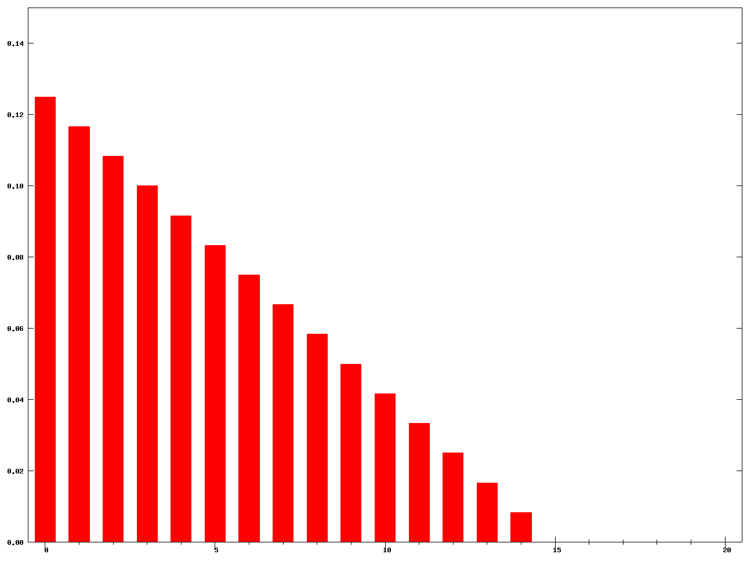
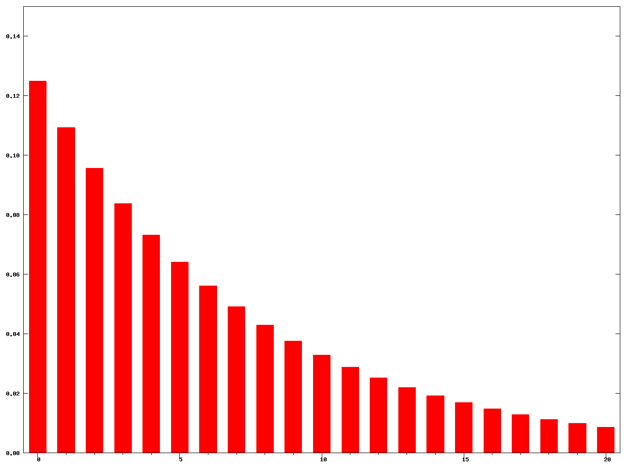
Moving Average
An simple moving average (SMA) computes a simple average of all past gradients up to and including the current iteration use that to update the parameters.
A weighted moving average (WMA) computes a weighted average of all gradients up to and including the current iteration where weights decrease linearly for each previous iteration ( i.e., more weights are assigned to recent gradients compared to the older ones)
An exponential moving average (EMA) similar to the weighted moving average, except that the weights decrease exponentially for each previous iteration
The distribution of weights in WMA(left) and EMA (right). The horizontal axis shows the iteration number from most recent to the least recent and the vertical axis shows the weights given to each iteration. In EMA the weights decreases exponentially for each previous iteration
WMA
EMA

Slide 37
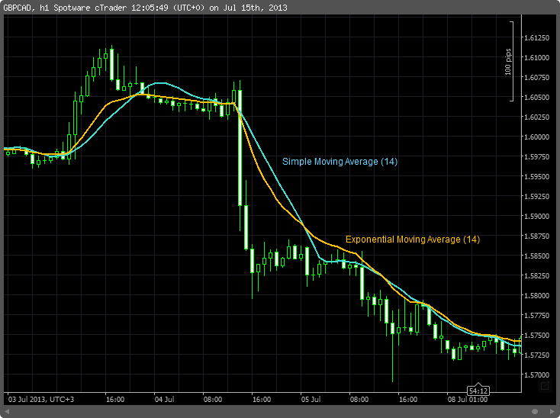
Moving Average (Cont.)
Moving average smooth out short term noise and fluctuations and highlights longer trends
Exponential moving average is more sensitive to changes in the data compared to simple moving average
Image source: https://en.wikipedia.org/wiki/Moving_average

Slide 38
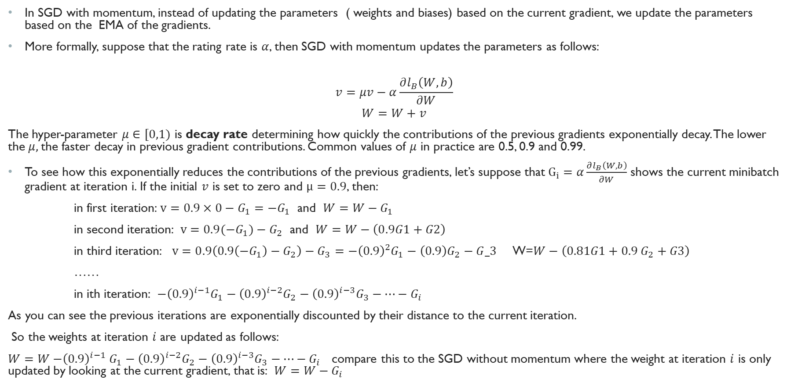
SGD with Momentum
In SGD with momentum, instead of updating the parameters ( weights and biases) based on the current gradient, we update the parameters based on the EMA of the gradients.
More formally, suppose that the rating rate is $α$, then SGD with momentum updates the parameters as follows:
$$v=μv−α\frac{∂l_{B}\left(W,b\right)}{∂W}$$
$$W=W+v$$
The hyper-parameter $μ∈[0,1)$ is decay rate determining how quickly the contributions of the previous gradients exponentially decay. The lower the $μ,$the faster decay in previous gradient contributions. Common values of $μ$ in practice are 0.5, 0.9 and 0.99.
To see how this exponentially reduces the contributions of the previous gradients, let’s suppose that $G_{i}=α\frac{∂l_{B}\left(W,b\right)}{∂W}$ shows the current minibatch gradient at iteration i. If the initial $v$ is set to zero and $μ=0.9$, then:
in first iteration: $v=0.9×0−G_{1}=−G_{1}$ and $W=W−G_{1}$
in second iteration: $v=0.9(−G_{1})−G_{2}$ and $W=W−\left(0.9G1+G2\right)$
in third iteration: $v=0.9\left(0.9\left(−G_{1}\right)−G_{2}\right)−G_{3}={−\left(0.9\right)}^{2}G_{1}−\left(0.9\right)G_{2}−G_3$ W=$W−\left(0.81G1+0.9 G_{2}+G3\right)$
……
in ith iteration: ${−\left(0.9\right)}^{i−1}G_{1}−{\left(0.9\right)}^{i−2}G_{2}−{\left(0.9\right)}^{i−3}G_{3}−…−G_{i}$
As you can see the previous iterations are exponentially discounted by their distance to the current iteration.
So the weights at iteration $i$ are updated as follows:
$W=W{−\left(0.9\right)}^{i−1}G_{1}−{\left(0.9\right)}^{i−2}G_{2}−{\left(0.9\right)}^{i−3}G_{3}−…−G_{i}$ compare this to the SGD without momentum where the weight at iteration $i$ is only updated by looking at the current gradient, that is: $W=W−G_{i}$

Slide 39
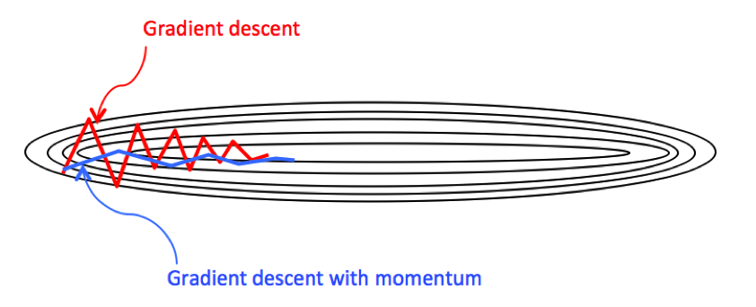
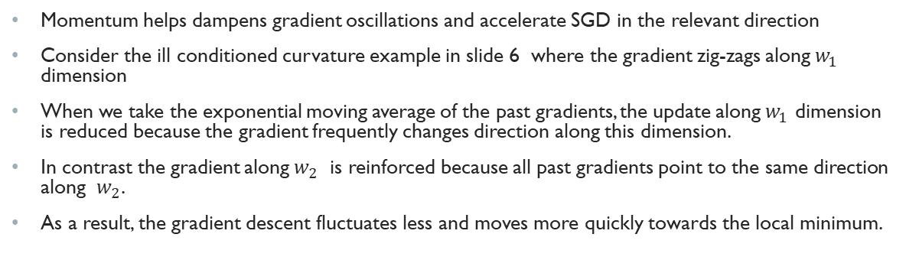


How does momentum help with gradient fluctuations
Momentum helps dampens gradient oscillations and accelerate SGD in the relevant direction
Consider the ill conditioned curvature example in slide 6 where the gradient zig-zags along $w_{1}$ dimension
When we take the exponential moving average of the past gradients, the update along $w_{1}$ dimension is reduced because the gradient frequently changes direction along this dimension.
In contrast the gradient along $w_{2}$ is reinforced because all past gradients point to the same direction along $w_{2}$.
As a result, the gradient descent fluctuates less and moves more quickly towards the local minimum.
$$w_{1}$$
contour
$$w_{2}$$

Slide 40
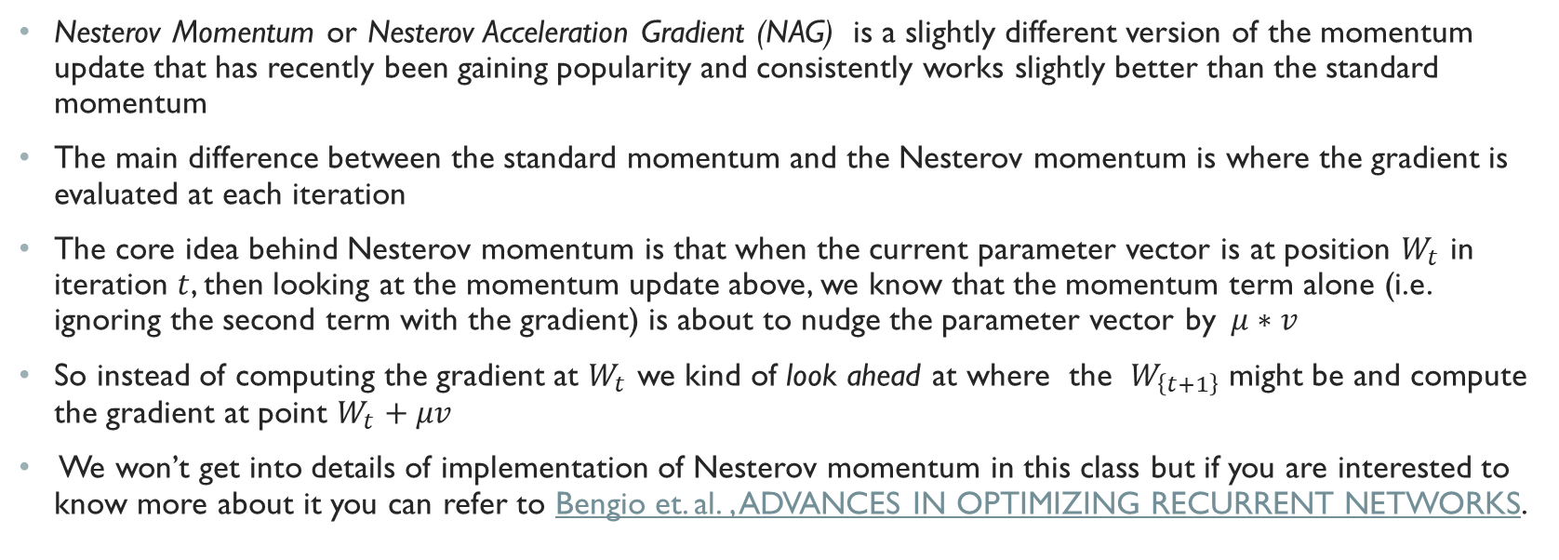
Nesterov Momentum
Nesterov Momentum or Nesterov Acceleration Gradient (NAG) is a slightly different version of the momentum update that has recently been gaining popularity and consistently works slightly better than the standard momentum
The main difference between the standard momentum and the Nesterov momentum is where the gradient is evaluated at each iteration
The core idea behind Nesterov momentum is that when the current parameter vector is at position $W_{t}$ in iteration $t$, then looking at the momentum update above, we know that the momentum term alone (i.e. ignoring the second term with the gradient) is about to nudge the parameter vector by$μ∗v$
So instead of computing the gradient at $W_{t}$ we kind of look ahead at where the $W_{\left\{t+1\right\}}$ might be and compute the gradient at point $W_{t}+μv$
We won’t get into details of implementation of Nesterov momentum in this class but if you are interested to know more about it you can refer to Bengio et. al. , ADVANCES IN OPTIMIZING RECURRENT NETWORKS.

Slide 41
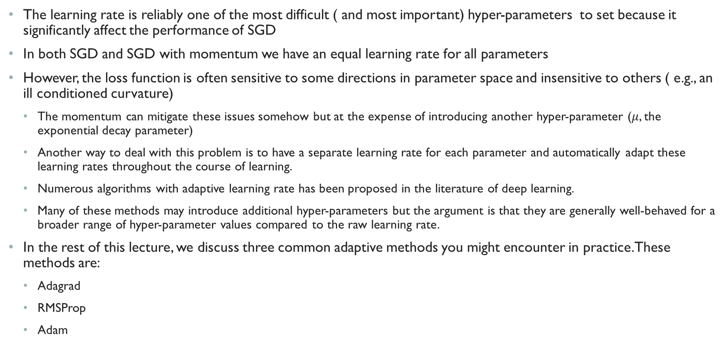
Algorithms with Adaptive Learning rate
The learning rate is reliably one of the most difficult ( and most important) hyper-parameters to set because it significantly affect the performance of SGD
In both SGD and SGD with momentum we have an equal learning rate for all parameters
However, the loss function is often sensitive to some directions in parameter space and insensitive to others ( e.g., an ill conditioned curvature)
The momentum can mitigate these issues somehow but at the expense of introducing another hyper-parameter ($μ$, the exponential decay parameter)
Another way to deal with this problem is to have a separate learning rate for each parameter and automatically adapt these learning rates throughout the course of learning.
Numerous algorithms with adaptive learning rate has been proposed in the literature of deep learning.
Many of these methods may introduce additional hyper-parameters but the argument is that they are generally well-behaved for a broader range of hyper-parameter values compared to the raw learning rate.
In the rest of this lecture, we discuss three common adaptive methods you might encounter in practice. These methods are:
Adagrad
RMSProp
Adam

Slide 42
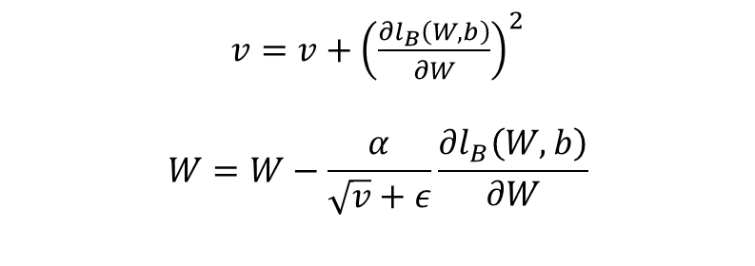
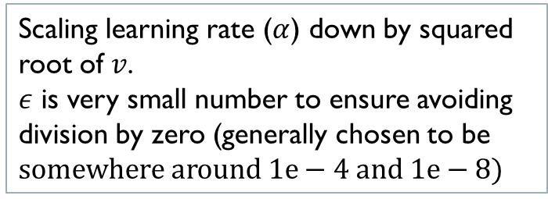
Adagrad Optimizer
The AdaGrad algorithm (introduced in this paper) adapts the learning rate for each parameter by scaling them inversely proportional to the square root of the sum of all historical squared values of the gradients.
$v=v+$ ${\left(\frac{∂l_{B}\left(W,b\right)}{∂W}\right)}^{2}$
$$W=W−\frac{α}{\sqrt{v}+ε}\frac{∂l_{B}\left(W,b\right)}{∂W}$$
Sum of the historic squared gradients
Squared current mini-batch gradient
Scaling learning rate ($α$) down by squared root of $v$.
$ε$ is very small number to ensure avoiding division by zero (generally chosen to be $somewhere around 1e−4 and 1e−8)$

Slide 43
Adagrad Pros and Cons
In Adagrad, the parameters with the largest partial derivative of the loss have a correspondingly rapid decrease in their learning rate while parameters with small partial derivatives have a relatively small decrease in their learning rate.
The net effect is greater progress in the more gently sloped directions of parameter space
Empirically, however, for training deep neural network models, the accumulation of squared gradients from the beginning of training can result in a premature and excessive decrease in the eﬀective learning rate.
In other words Adagrad can reduce the learning rate too aggressively and stops learning too early
Adagrad works well for some but not all deep learning models

Slide 44
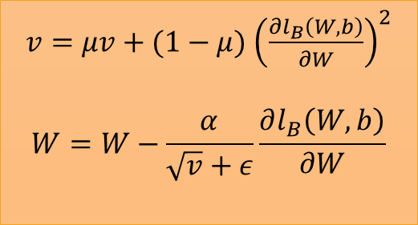
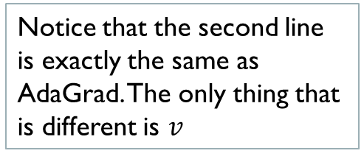
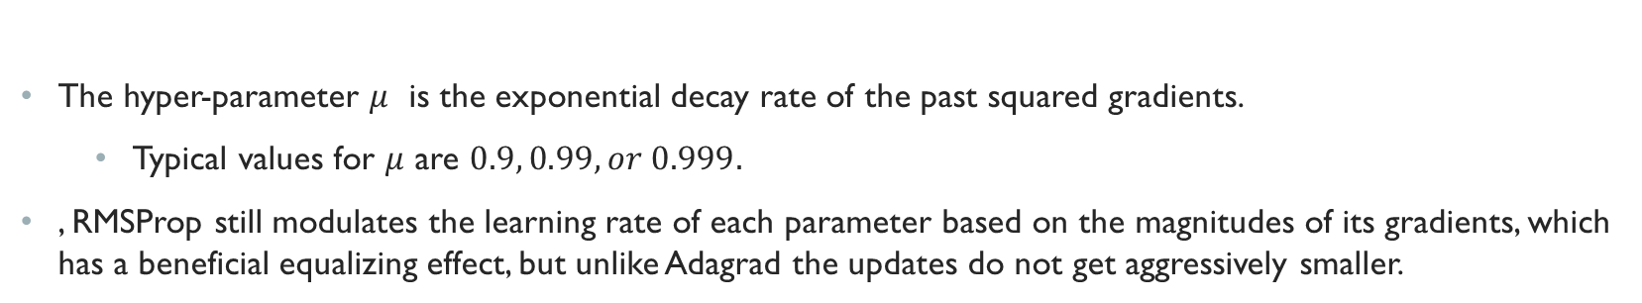
RMSProp Optimizer
RMSProp is similar to AdaGrad in that it scales the learning rate based on accumulation of historic gradients.
However, instead of using, square root of the sum of the past squared gradients RMSProp uses exponential moving average of the past squared gradient to scale the learning rate.
RMSProp improves Adagrad by giving an exponentially decaying weights to the past square gradients discarding history from the extreme past and reducing the aggressive decreasing of learning rate in AdaGrad.
Interestingly, RMSProp was never published and was introduced for the first time by Geoff Hinton in a coursera class.
$v=μv+(1−μ)$ ${\left(\frac{∂l_{B}\left(W,b\right)}{∂W}\right)}^{2}$
$$W=W−\frac{α}{\sqrt{v}+ε}\frac{∂l_{B}\left(W,b\right)}{∂W}$$
The exponential weighted average of the historic squared gradients
Notice that the second line is exactly the same as AdaGrad. The only thing that is different is $v$
The hyper-parameter $μ$ is the exponential decay rate of the past squared gradients.
Typical values for $μ$ are $0.9, 0.99, or 0.999.$
, RMSProp still modulates the learning rate of each parameter based on the magnitudes of its gradients, which has a beneficial equalizing effect, but unlike Adagrad the updates do not get aggressively smaller.

Slide 45
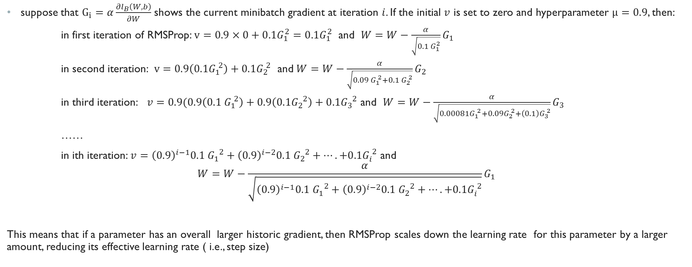
RMSProp (Cont.)
suppose that $G_{i}=α\frac{∂l_{B}\left(W,b\right)}{∂W}$ shows the current minibatch gradient at iteration $i$. If the initial $v$ is set to zero and hyperparameter $μ=0.9$, then:
in first iteration of RMSProp: $v=0.9×0+0.1G_{1}^{2}=0.1G_{1}^{2}$ and $W=W−\frac{α}{\sqrt{0.1 G_{1}^{2}}}G_{1}$
in second iteration: $v=0.9\left(0.1G_{1}^{ 2}\right)+{0.1G}_{2}^{ 2}$ and$W=W−\frac{α}{\sqrt{0.09 G_{1}^{ 2}+0.1 G_{2}^{ 2}}}G_{2}$
in third iteration: $v=0.9(0.9\left(0.1 G_{1}^{ 2}\right)+0.9\left(0.1G_{2}^{ 2}\right)+0.1G_{3}^{ 2}$ and $W=W−\frac{α}{\sqrt{{0.00081G}_{1}^{ 2}+{0.09G}_{2}^{ 2}+\left(0.1\right)G_{3}^{ 2}}}G_{3}$
……
in ith iteration: $v={\left(0.9\right)}^{i−1}0.1 G_{1}^{ 2}+{\left(0.9\right)}^{i−2}0.1 G_{2}^{ 2}+….+0.1G_{i}^{ 2}$ and
$$W=W−\frac{α}{\sqrt{{\left(0.9\right)}^{i−1}0.1 G_{1}^{ 2}+{\left(0.9\right)}^{i−2}0.1 G_{2}^{ 2}+….+0.1G_{i}^{ 2}}}G_{1}$$
This means that if a parameter has an overall larger historic gradient, then RMSProp scales down the learning rate for this parameter by a larger amount, reducing its effective learning rate ( i.e., step size)

Slide 46
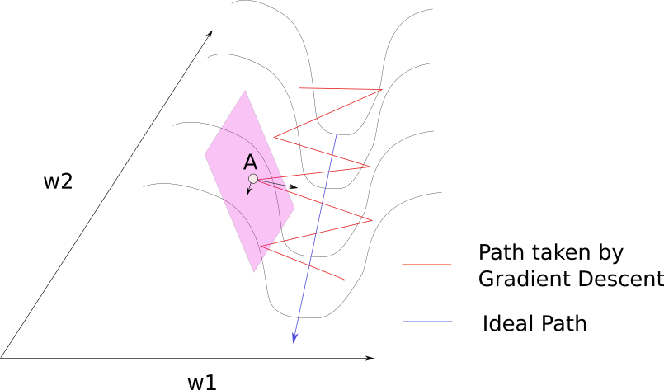
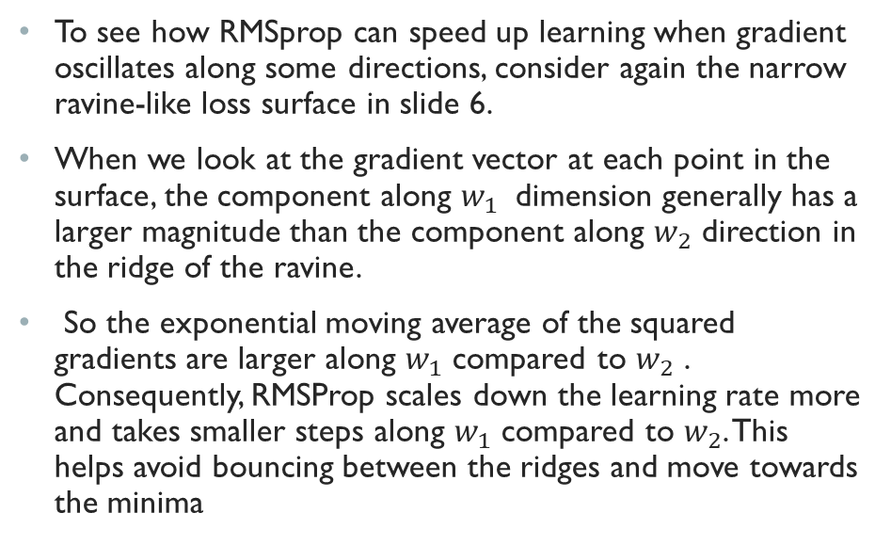
RMSProp and Gradient Oscillations
To see how RMSprop can speed up learning when gradient oscillates along some directions, consider again the narrow ravine-like loss surface in slide 6.
When we look at the gradient vector at each point in the surface, the component along $w_{1}$ dimension generally has a larger magnitude than the component along $w_{2}$ direction in the ridge of the ravine.
So the exponential moving average of the squared gradients are larger along $w_{1}$ compared to $w_{2}$ . Consequently, RMSProp scales down the learning rate more and takes smaller steps along $w_{1}$ compared to $w_{2}$. This helps avoid bouncing between the ridges and move towards the minima
Image source: https://blog.paperspace.com/intro-to-optimization-momentum-rmsprop-adam/

Slide 47
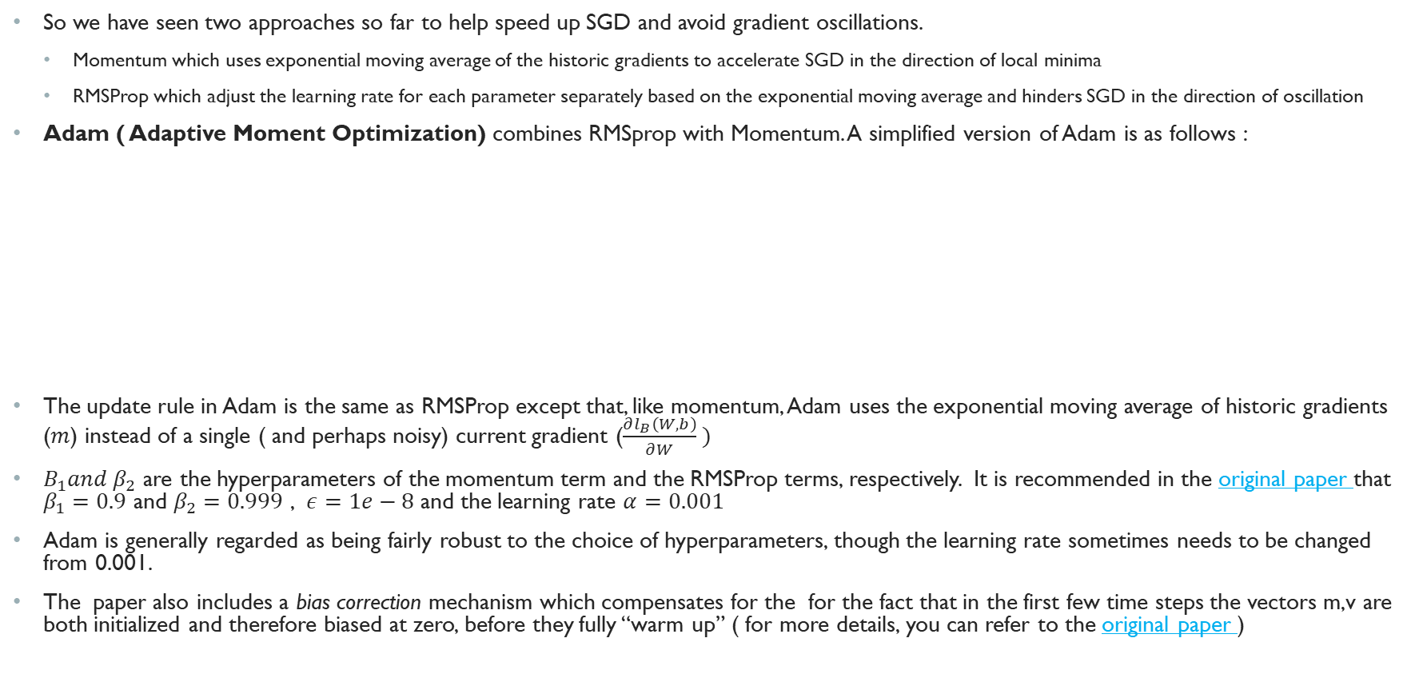

Adam Optimizer
So we have seen two approaches so far to help speed up SGD and avoid gradient oscillations.
Momentum which uses exponential moving average of the historic gradients to accelerate SGD in the direction of local minima
RMSProp which adjust the learning rate for each parameter separately based on the exponential moving average and hinders SGD in the direction of oscillation
Adam ( Adaptive Moment Optimization) combines RMSprop with Momentum. A simplified version of Adam is as follows :
The update rule in Adam is the same as RMSProp except that, like momentum, Adam uses the exponential moving average of historic gradients ($m$) instead of a single ( and perhaps noisy) current gradient ($\frac{∂l_{B}\left(W,b\right)}{∂W} )$
$B_{1}and β_{2}$ are the hyperparameters of the momentum term and the RMSProp terms, respectively. It is recommended in the original paper that $β_{1}=0.9$ and $β_{2}=0.999$ , $ε=1e−8$ and the learning rate $α=0.001$
Adam is generally regarded as being fairly robust to the choice of hyperparameters, though the learning rate sometimes needs to be changed from 0.001.
The paper also includes a bias correction mechanism which compensates for the for the fact that in the first few time steps the vectors m,v are both initialized and therefore biased at zero, before they fully “warm up” ( for more details, you can refer to the original paper )
$v=B_{2}v+(1−β_{2})$ ${\left(\frac{∂l_{B}\left(W,b\right)}{∂W}\right)}^{2}$
$$m=B_{1}m+(1−β_{1})\frac{∂l_{B}\left(W,b\right)}{∂W}$$
$$W=W−\frac{α}{\sqrt{v}+ε}m$$

Slide 48
Which optimizer to choose
There is no consensus on which optimization algorithm one should choose
This paper presented a comparison of a large number of optimization algorithms across a wide range of learning tasks. They concluded that algorithms with adaptive learning rates performed fairly robustly but no single best algorithm emerged.
In practice Adam is currently recommended as the default algorithm to use, and often works slightly better than RMSProp. In many applications it is also worth trying SGD+momentum as an alternative.
In a recent paper Wilson et. Al. observed that the solutions found by adaptive learning rate methods generalize worse than SGD ( and SGD with momentum) even when these methods have better training performance. The authors of this paper invite the deep learning community to reconsider using adaptive method.

Slide 49
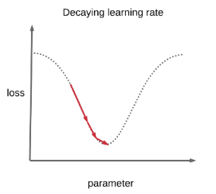
Learning Rate decay
So we learned that optimizers such as Adam and RMSProp adjust the learning rate per parameter.
In addition to per parameter adjustment, it might be helpful in deep neural networks to also decay the learning rate over time. This is referred to as learning rate decay or learning rate scheduling.
The reason we want to decay the learning rate is because gradients computed on minibatches randomly sampled from the training data introduce a source of noise that does not vanish even when we arrive at a local minimum.
In contrast, the true gradient of the total cost function becomes small and then approaches zero when we reach a minimum using batch gradient descent, where the gradients are computed on the entire data instead of a random subset.
Therefore, in practice it is common to decay the learning rate over time in a minibatch gradient descent. Learning rate decay is empirically observed to help with both optimization and generalization.
A common belief is that an initially large learning rate accelerates training up to a certain point but as we get closer to the local minima, it is better to have a smaller learning rate to avoid oscillations.
There are three common ways to implement learning rate decay: step decay, exponential decay, and 1/t decay.
Learning rate decay in one dimension. Initially, it makes sense to take larger steps to make larger updates to the parameters but as we get close to the local minimum, we want to take smaller steps ( smaller updates) to avoid oscillation

Slide 50
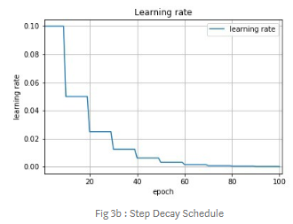
Step Decay learning rate schedule
Step decay reduces the learning rate by a constant factor every few epochs.
That is, the learning rate is reduced by a piecewise constant function
An epoch is a pass (both forward and backward) through the entire training data. An epoch consists of one or more minibatches.
For instance, a step decay can drop the learning rate by half every 10 epochs or by 0.1 every 20 epochs.
Step decay has two hyper-parameters: decay rate and decay step.
The learning rate is reduced by decay rate at every decay step epochs
One heuristic you may see in practice is to first train with a fixed learning rate and find when epoch the validation error stops improving. Then reduce the learning rate by a constant and continue the training.
An example of step decay reducing the learning rate by half every 10 epochs
Image source here

Slide 51
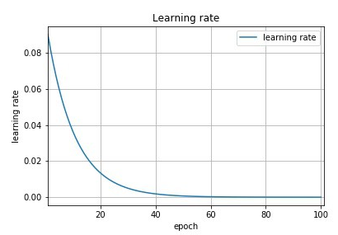
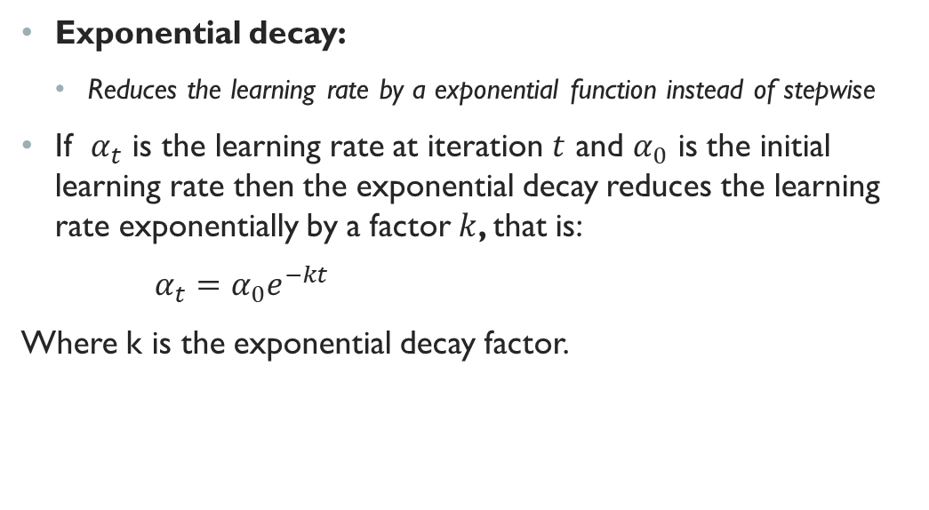
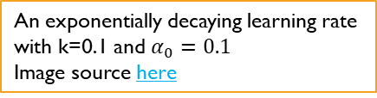
Exponential decay learning rate schedule
Exponential decay:
Reduces the learning rate by a exponential function instead of stepwise
If $α_{t}$ is the learning rate at iteration $t$ and $α_{0}$ is the initial learning rate then the exponential decay reduces the learning rate exponentially by a factor $k$, that is:
$α_{t}=α_{0}e^{−kt}$
Where k is the exponential decay factor.
An exponentially decaying learning rate with k=0.1 and $α_{0}=0.1$
Image source here

Slide 52
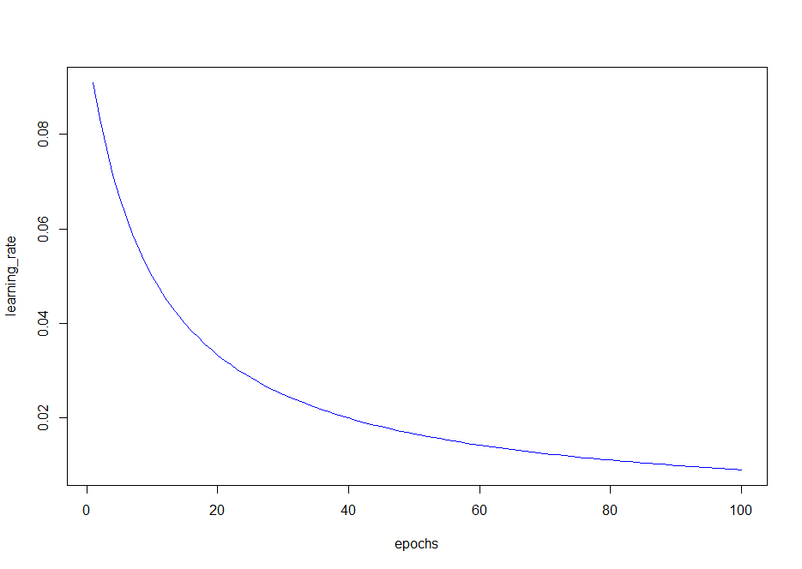


1/t decay learning rate schedule
Reduces the learning rate based on the following formula:
If we can afford the computational budget, it is better to have a slower decay but train for a longer time.
$$α_{t}=\frac{α_{0}}{1+kt}$$
1/t learning rate decay with k=0.1 and $α_{0}=0.1$

Slide 53
Other Considerations for Speeding up gradient descent
Normalizing input
Batch Normalization

Slide 54
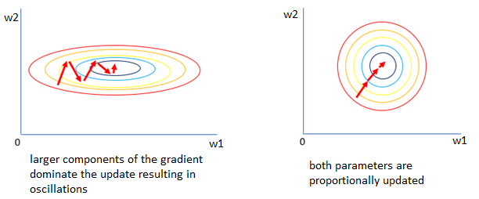

Normalizing Input
Normalizing input data is a common pre-processing step in many machine learning algorithms that are sensitive to the scale of data.
The scale of input data can affect the performance of neural networks
If the input features are on different scales, the gradients with respect to the weights are also on different scale ( this is because the gradient of $WX+b$ operation depends on $X$) .
This can cause gradient descent algorithm to take larger steps along the dimensions with larger gradients and possibly fluctuate leading to slower progress of the learning algorithm. In that sense, normalizing input can help speed up the gradient descent learning
Image source: here

Slide 55


Normalizing Input(Cont.)
A common method to normalize input is to center data by subtracting the mean across every individual feature in the data and then scale each feature by dividing it by its standard deviation.
This normalization is sometimes referred to as z-score normalization or standardization.
$x_{i}=\frac{{(x}_{i}−μ_{i})}{σ_{i}}$
Where $x_{i}$ is the ith feature vector in the input data and $μ_{i}$ and $σ_{i}$ are its sample mean and standard deviations, respectively.
This will force each individual input feature to have mean zero and standard deviation 1.
Normalization centers the data around origin and bring all features in the same relative scale.
Image source: https://cs231n.github.io/neural-networks-2/#datapre

Slide 56

Normalizing Input (Cont.)
An important point to make about the preprocessing is that, any preprocessing statistics (such as mean and standard deviation) must be computed based on the training data only and then be applied to test and validation sets.
For instance, scaling the entire dataset before splitting it to train/test/validation is a common mistake and can potentially lead to biased estimates of error.
Instead, one should first split the data to train/test/validation, compute the mean and standard deviation based on the train data only and apply it to scale the test and validation data
For image data, another type of normalization is also common and that is, dividing every pixel value ( which is in rage 0-255) by 255 to bring all values in the range $[0,1]$
For image, all pixel values are already in the same relative scale (0-255 range) so dividing by standard deviation is not necessary.
One can however, center the pixel values or divide them by the maximum value (255) to avoid the linear term $WX+B$ to get too large

Slide 57




Batch Normalization
Normalizing input will put the inputs to the first hidden layer at similar scale but what about the input to the other layers?
As we have seen before, when we discussed weight initialization, there is no guarantee that the inputs to other hidden layers be at similar scale as we move forward layer by layer computing the activations.
for a typical deep neural network the activations of the hidden layers may take values with widely varying magnitudes both along layers from input to the output, across nodes in the same layer, and over time due to updates to the model parameters.
Even if we use careful initialization ( such as He-normal) there is no guarantee that the variance of the activations remain constant over time due to the update to the model parameters.
A technique called Batch normalization extends the input normalization to the hidden layers by normalizing the input to the activation function in all hidden layers and throughout the network.
A neuron in layer $l$ with batch normalization:
first computes a$ffine transformation {{z_{i}^{\left[l\right]}=w}_{i}^{\left[l\right]}}^{T}a_{i}^{\left[l−1\right]}$
Then normalizes the result: $Z_{i}^{N\left[l\right]}=BN(z_{i}^{\left[l\right]})$
And finally applies a non-linear activation function to compute its output: $a_{i}^{\left[l+1\right]}=g^{\left[l\right]}(z_{i}^{N\left[l\right]})$
$$a^{\left[l−1\right]}$$
$g^{\left[l\right]}(BN({w_{i}^{\left[l\right]}}^{T}a^{\left[l−1\right]}$))
$$<w_{i}^{\left[l\right]},b_{i}^{\left[l\right]}>$$
Non linear activation
Batch Norm
Linear combination

Slide 58

Computing Batch Norm
You might have noticed that in the previous slide I used ${{z_{i}^{\left[l\right]}=w}_{i}^{\left[l\right]}}^{T}a_{i}^{\left[l\right]}$ instead of our usual ${{z_{i}^{\left[l\right]}=w}_{i}^{\left[l\right]}}^{T}a_{i}^{\left[l\right]}+b_{i}^{\left[l\right]}$. So where did the bias term go?
Since we are centering around zero $z_{i}^{\left[l\right]}$ by subtracting the mean, the bias term gets canceled out so there is no point in adding it when computing $z_{i}^{\left[l\right]}$
The batch normalization computes the following function for neuron $i$ in layer $l$:
$BN\left(z_{i}^{\left[l\right]}\right)=γ_{i}^{\left[l\right]} \frac{{z_{i}^{\left[l\right]}−μ}_{i}^{\left[l\right]}}{σ_{i}^{\left[l\right]}}+β_{i}^{\left[l\right]}$
Let’s break out this formula to see what each term does:
The term $\frac{{z_{i}^{\left[l\right]}−μ}_{i}^{\left[l\right]}}{σ_{i}^{\left[l\right]}}$ just centers and scale $z_{i}^{\left[l\right]}$ to have mean zero and standard deviation 1 (similar to what we did with the input normalization). Important Note: The mean $μ_{i}^{\left[l\right]}$ and standard deviation $σ_{i}^{\left[l\right]}$ are computed over the data examples in the minibatch (instead of the entire training data) hence the name batch normalization.
The choice of normalizing $z_{i}^{\left[l\right]}$ to have a mean zero (i.e., zero offset) and standard deviation 1 (i.e., scale 1) is rather arbitrary. Rather than choosing arbitrary values for the scale and offset, we can let the network learn these values.
The parameter $γ_{i}^{\left[l\right]}$ is the scale of data after normalization and parameter $β_{i}^{\left[l\right]}$ is the offset of data after normalization. These parameters are learned and updated by gradient descent the same way that other network weights are learned.

Slide 59


Batch Normalization during training
The following computational graph shows how batch normalization fit into forward and backward passes during the training using gradient descent
(The gradients are all computed over minibatch but for simplicity we removed the subscript for the minibatch from the picture and formulas below)
And the parameters $W^{\left[l\right]},β^{\left[l\right]}, and γ^{\left[l\right]}$ are updated using SGD or one of its variants (Adam, RMSProp, etc.):
$W^{\left[l\right]}=W^{\left[l\right]}−α\frac{∂l}{∂W^{\left[l\right]}}$
$β^{\left[l\right]}=β^{\left[l\right]}−α\frac{∂l}{∂β^{\left[l\right]}}$
$γ^{\left[l\right]}=γ^{\left[l\right]}−α\frac{∂l}{∂γ^{\left[l\right]}}$
$\frac{∂l}{∂Z^{N\left[l\right]}}=\frac{∂l}{∂A^{\left[l\right]}}∗\frac{∂g^{\left[l\right]}}{∂{ZN}^{\left[l\right]}} , \frac{∂l}{∂Z^{\left[l\right]}}=\frac{∂l}{∂Z^{N\left[l\right]}}∗\frac{∂BN}{∂Z^{\left[l\right]}} , \frac{∂l}{∂β^{\left[l\right]}}=\frac{∂l}{∂Z^{N\left[l\right]}}∗\frac{∂BN}{∂β^{\left[l\right]}}, \frac{∂l}{ ∂γ^{\left[l\right]}}=\frac{∂l}{∂Z^{N\left[l\right]}}∗\frac{∂BN}{∂γ^{\left[l\right]}}$ , $\frac{∂l}{∂W^{\left[l\right]}}=\frac{∂matmul}{∂W^{\left[l\right]}}∗\frac{∂l}{∂Z^{\left[l\right]}}$

Slide 60
Batch Normalization During Testing
During training, we compute the batch normalization and its gradient per minibatch of training data
During testing however, we might want to do the prediction for one data example at a time. In that case, how do we compute the mean and standard deviation for batch norm function in each neuron?
One could use the statistics (means and standard deviations) from the last minibatch during the training but that could cause the predictions to be noisy and sensitive to the choice of minibatch in the last iteration.
Alternatively, we could compute the mean and standard deviation of the entire training dataset and use that for the batchnorm function during testing (prediction)
Another alternatives is to keep track of the moving average or exponential moving average of the minibatch statistics during training and use that at test time.

Slide 61
Why using Batch Normalization?
Batch normalization is one of the most influential techniques in training a deep neural network and has become a very common practice in deep learning community.
Batch normalization can be interpreted as doing preprocessing at every layer of the network, but integrated into the network itself in a differentiable manner ( its parameters are learned by the network)
In practice, networks that use batch normalization are significantly more robust to bad initialization due to the fact that they actively normalize the activations and gradients during training and keeping them from diverging.
Batch normalization is believed to speed up the learning algorithm by allowing for more aggressive learning rate without overshooting the parameters.
Batch normalization is also believed to have some regularization effect in a sense that it leads to better generalization compared to a network that did not use batch norm.
If you are interested to know more on how batch normalization helps optimization, you can refer to this paper.

